Slide 1

Welcome by Soulmate Entertainment
Warm Welcome
Soulmate Entertainment extends a warm welcome to all our clients, ensuring a friendly and inviting atmosphere.
Exceptional Services
We strive to provide exceptional entertainment services tailored to meet the unique needs of each client.
Unforgettable Events
Our commitment is to deliver excellence and create memorable experiences through captivating performances and well-organized events.
Notes:
Soulmate Entertainment Company extends a warm welcome to you. As a proud vendor at Noor Mahal, we strive to provide exceptional entertainment services tailored to your needs. From captivating performances to unforgettable events, our commitment is to deliver excellence and create memorable experiences for all our clients.

Slide 2

Celebrating the Haldi Ceremony
A traditional pre-wedding ritual in many cultures.
Involves applying turmeric paste for its auspicious significance.
Symbolizes purity, beauty, and blessing for the bride and groom.
Often accompanied by singing, dancing, and festive decorations.
Friends and family play a key role in this joyous occasion.
Notes:
The Haldi Ceremony is an important ritual that takes place before the wedding, signifying the start of the celebrations. The application of turmeric, known for its purifying properties, is believed to bring good luck and enhance the glow of the bride and groom. It is a lively event filled with laughter, music, and the love of family and friends.

Slide 3
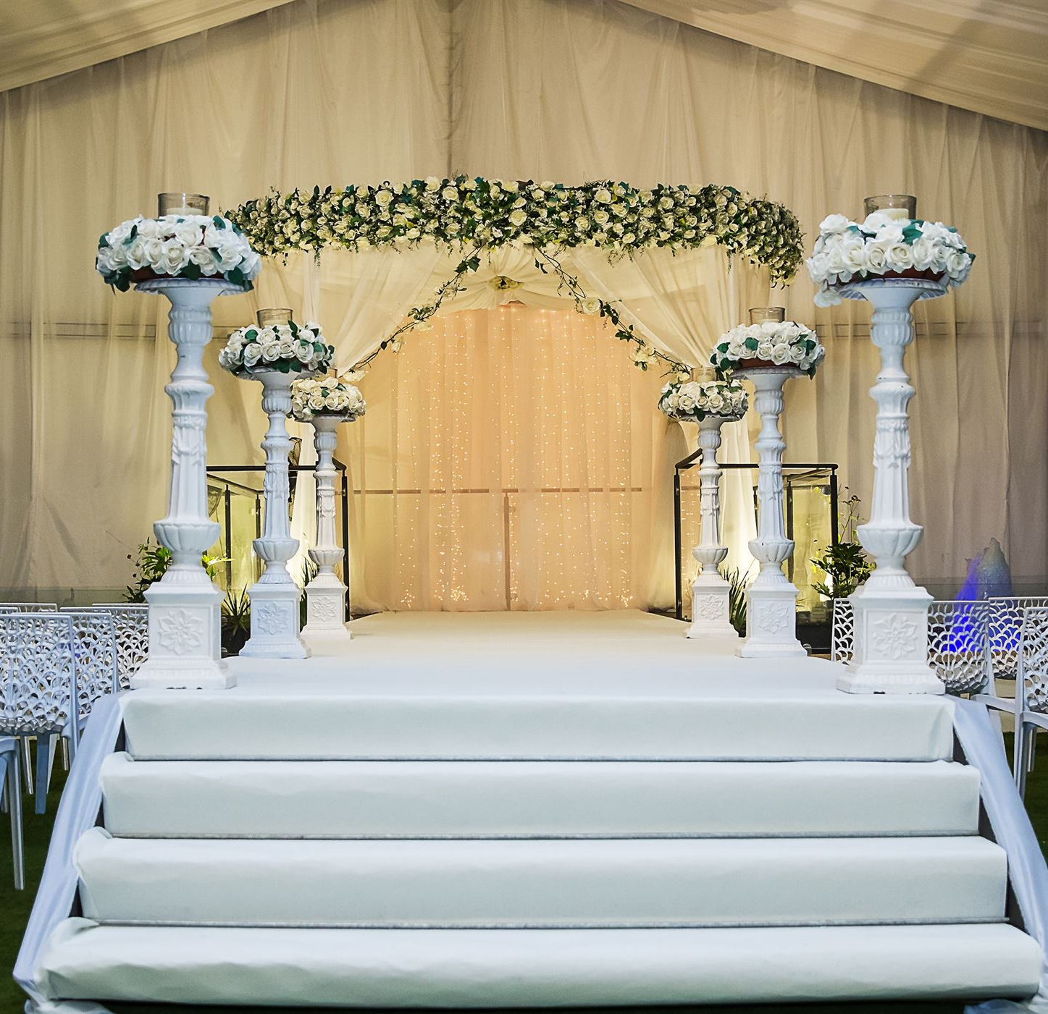
Day Haldi Setup
Sound System
A sound system is essential for ensuring the Haldi event is lively and enjoyable with music and announcements.
Flex Floor
A flex floor provides a comfortable and aesthetically pleasing area for guests to sit and participate in the Haldi rituals.
Joyful Atmosphere
Together, sound system and flex floor create a joyful and memorable atmosphere for the Haldi ceremony.
Notes:
The Day Haldi setup is a crucial part of wedding preparations. It includes a sound system to ensure the event is lively and enjoyable with music and announcements. Additionally, a flex floor is installed to provide a comfortable and aesthetically pleasing area for guests to sit and participate in the rituals. Together, these elements create a joyful and memorable atmosphere for the Haldi ceremony.

Slide 4
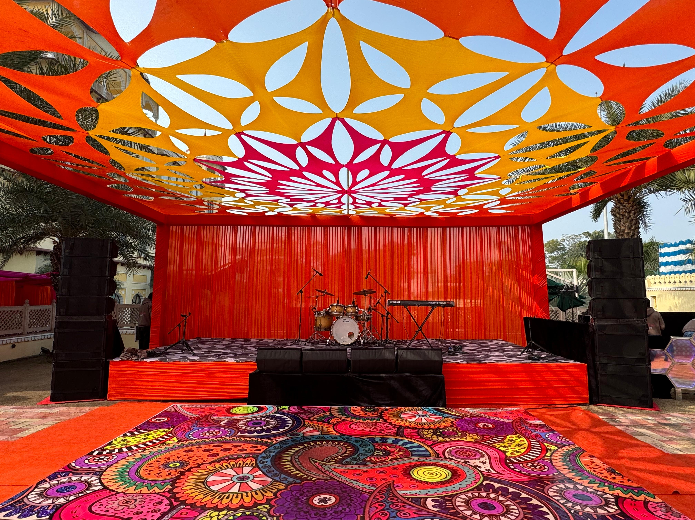

Slide 5
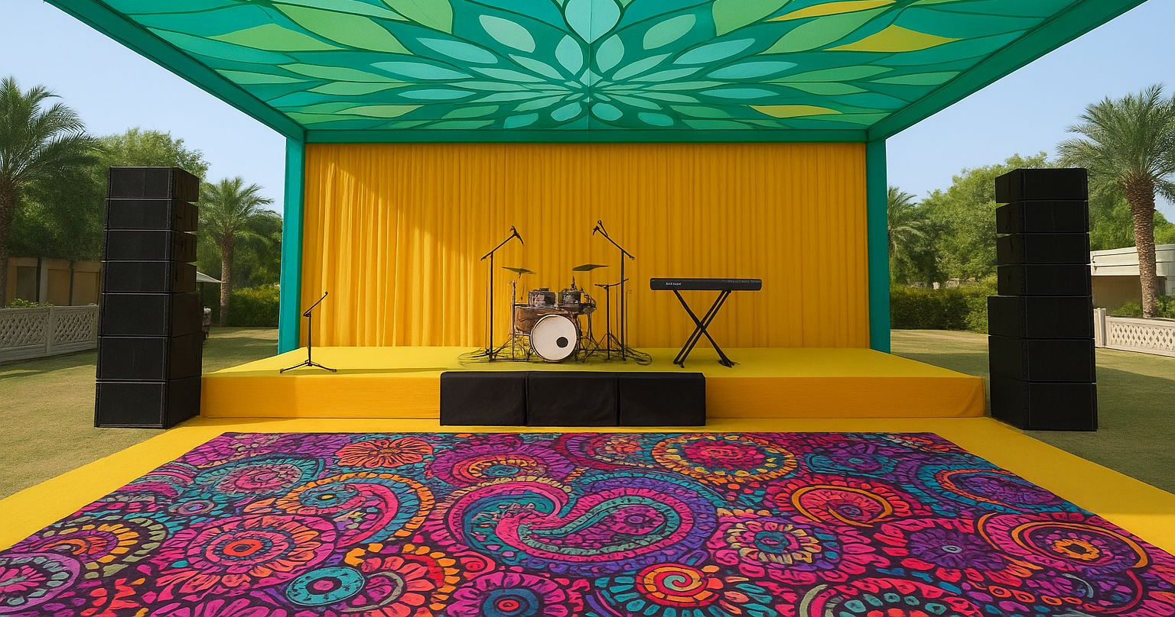

Slide 6
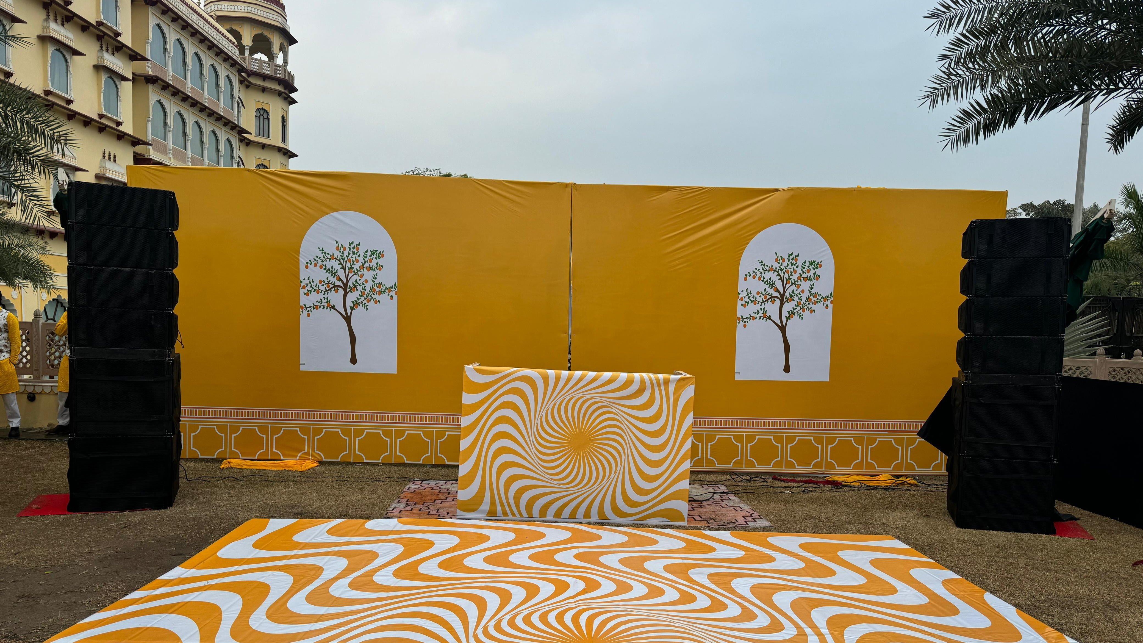

Slide 7
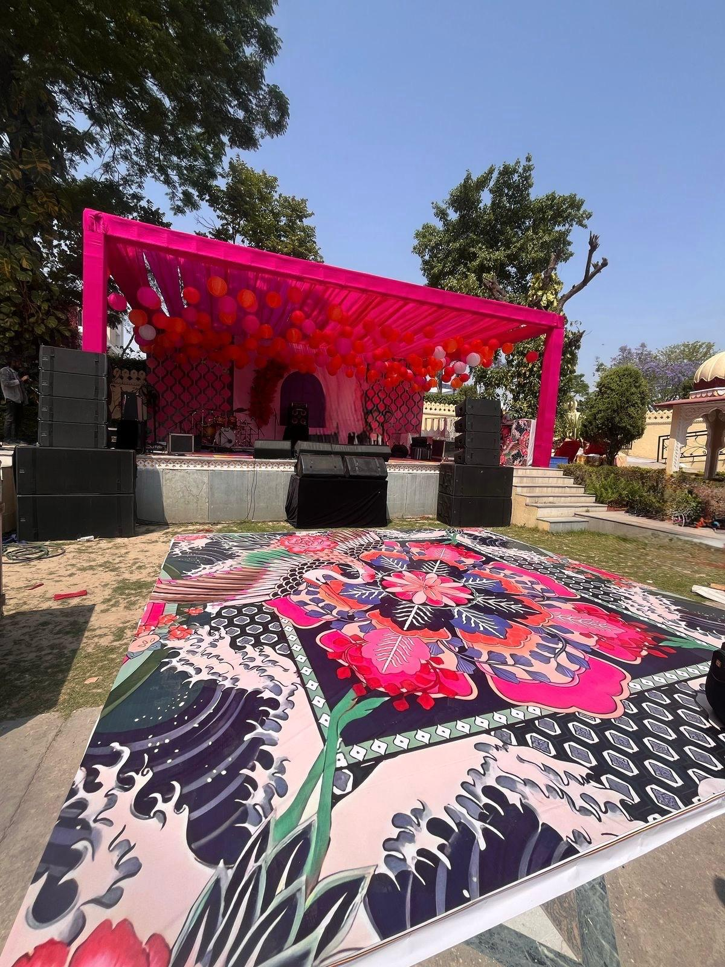
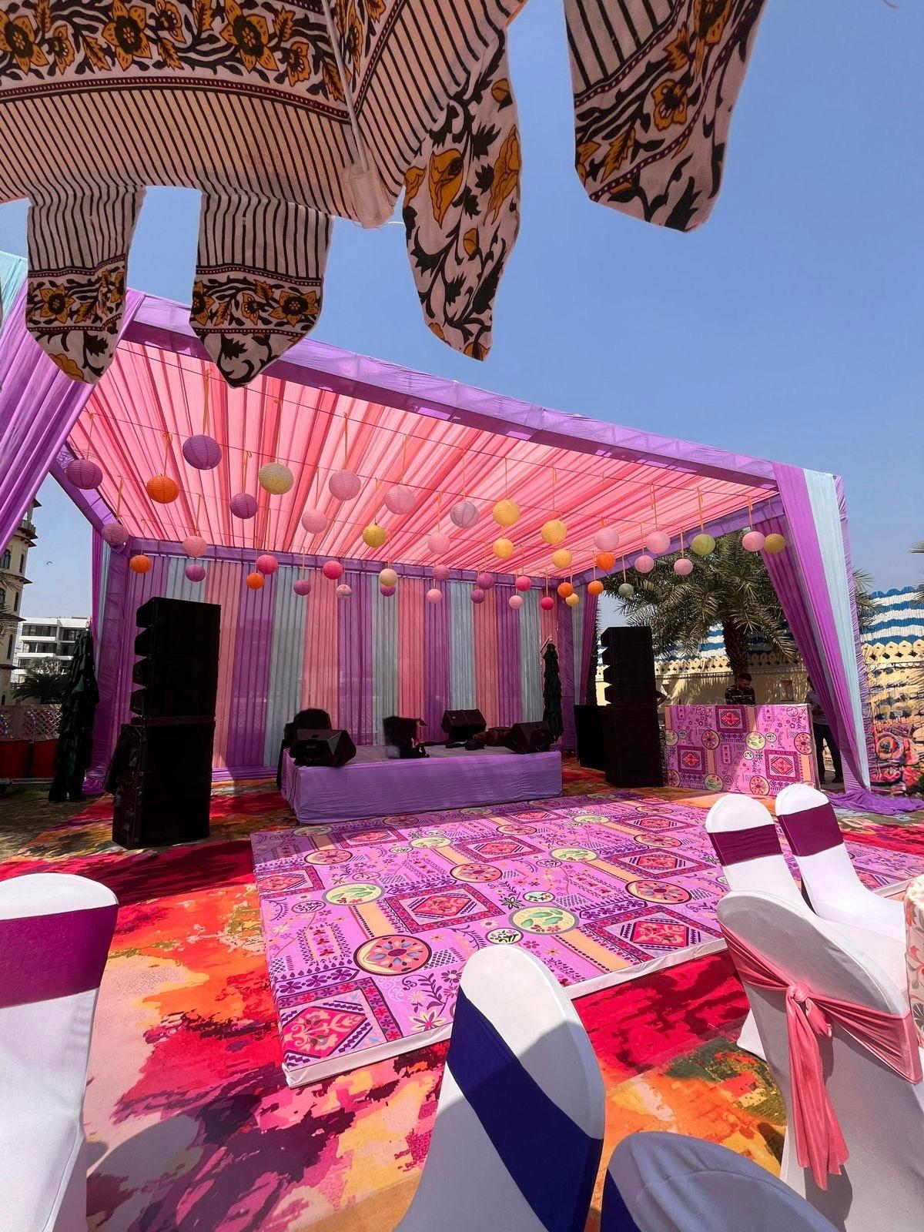
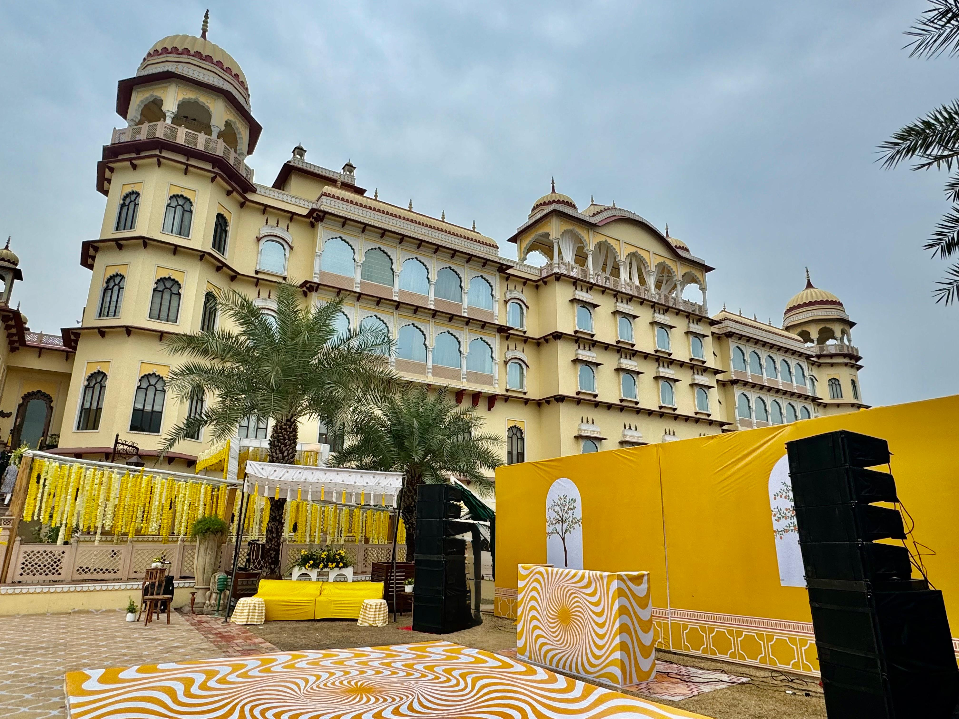

Slide 8
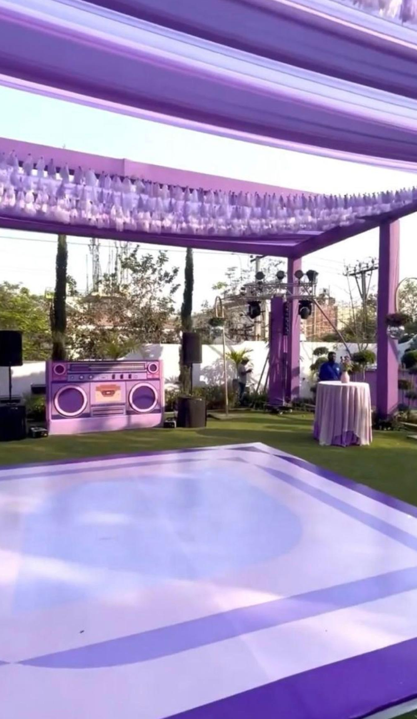
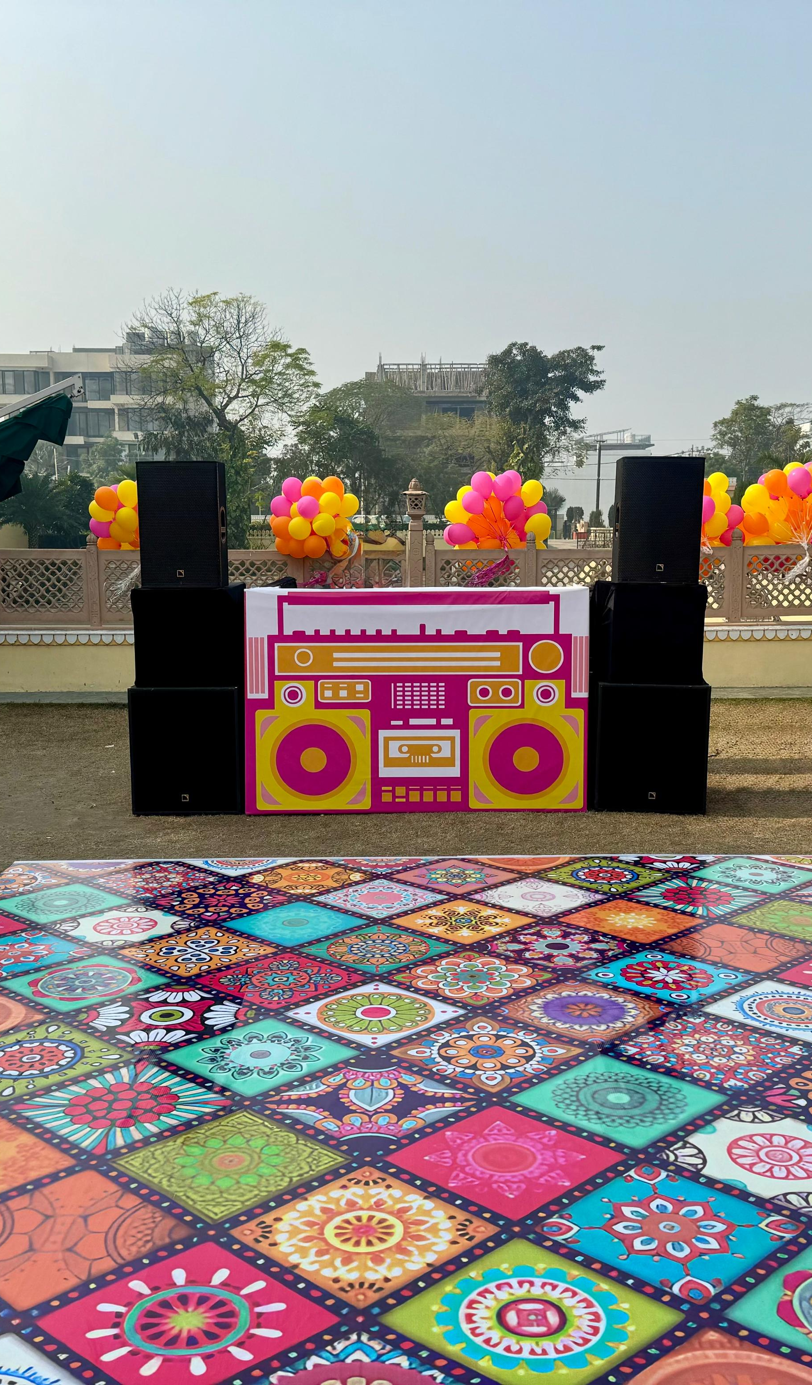
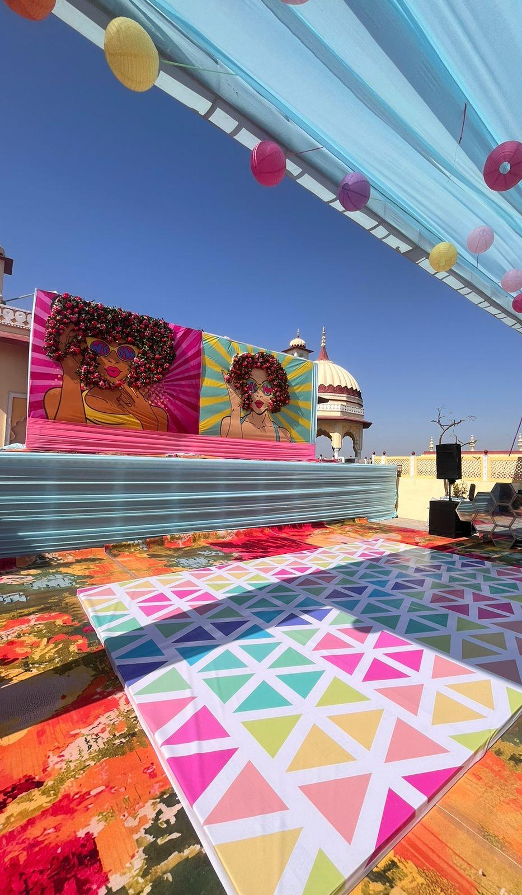

Slide 9
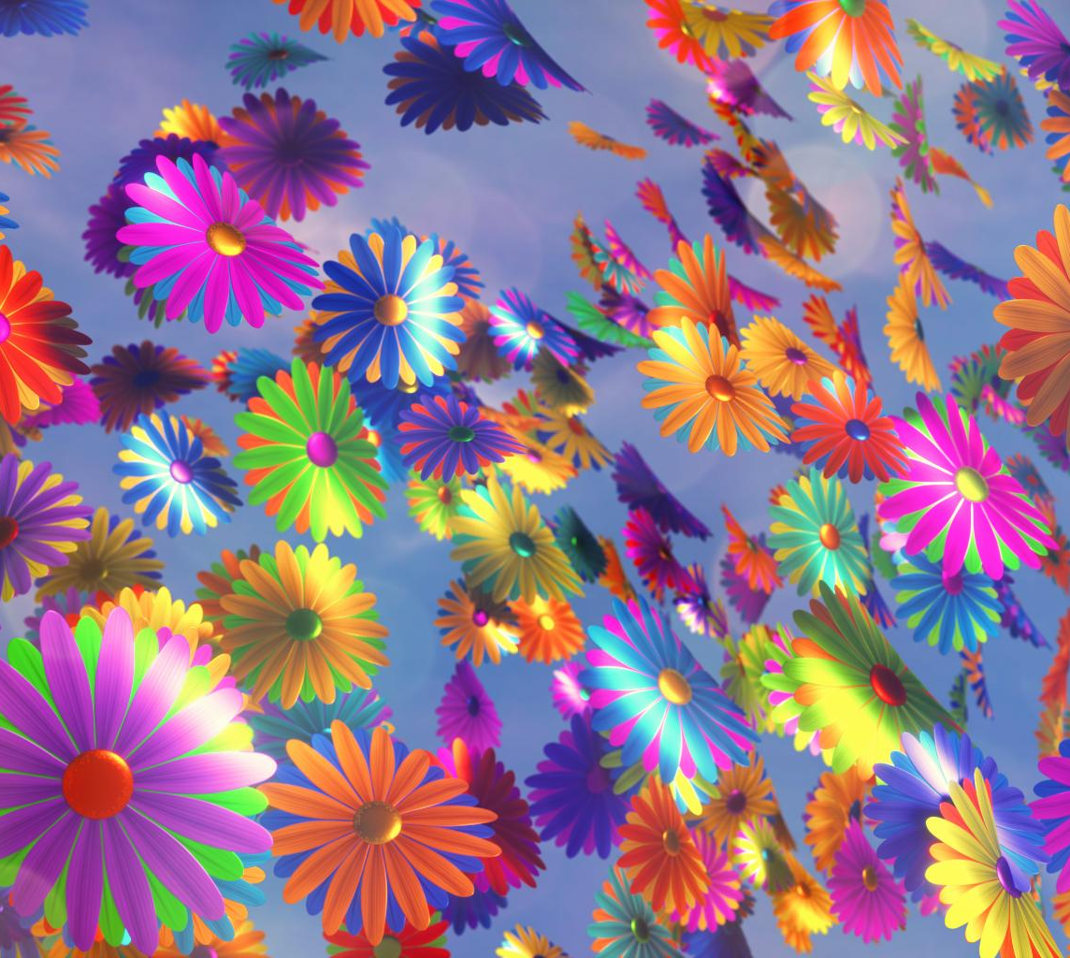
Exciting Party Additions
Color Guns and Shots
Add vibrant bursts of color to your event with color guns and shots for an energetic atmosphere.
Helium Balloons and Bubbles
Helium balloons and bubble machines create a whimsical and enchanting atmosphere for guests.
ATB Bike
An ATB bike adds a sporty touch to your event, appealing to adventurous guests.
Confetti and Flower Shower
A confetti and flower shower provides a magical ending, showering guests with joy and beauty.
Notes:
Make your event unforgettable with special effects like Color Guns and Color Shots, which add vibrant bursts of color. Helium Balloons and Bubble Machines create a whimsical atmosphere. An ATB Bike adds a sporty touch, while a Confetti Shower and Flower Shower provide a magical ending, showering guests with joy and beauty.

Slide 10
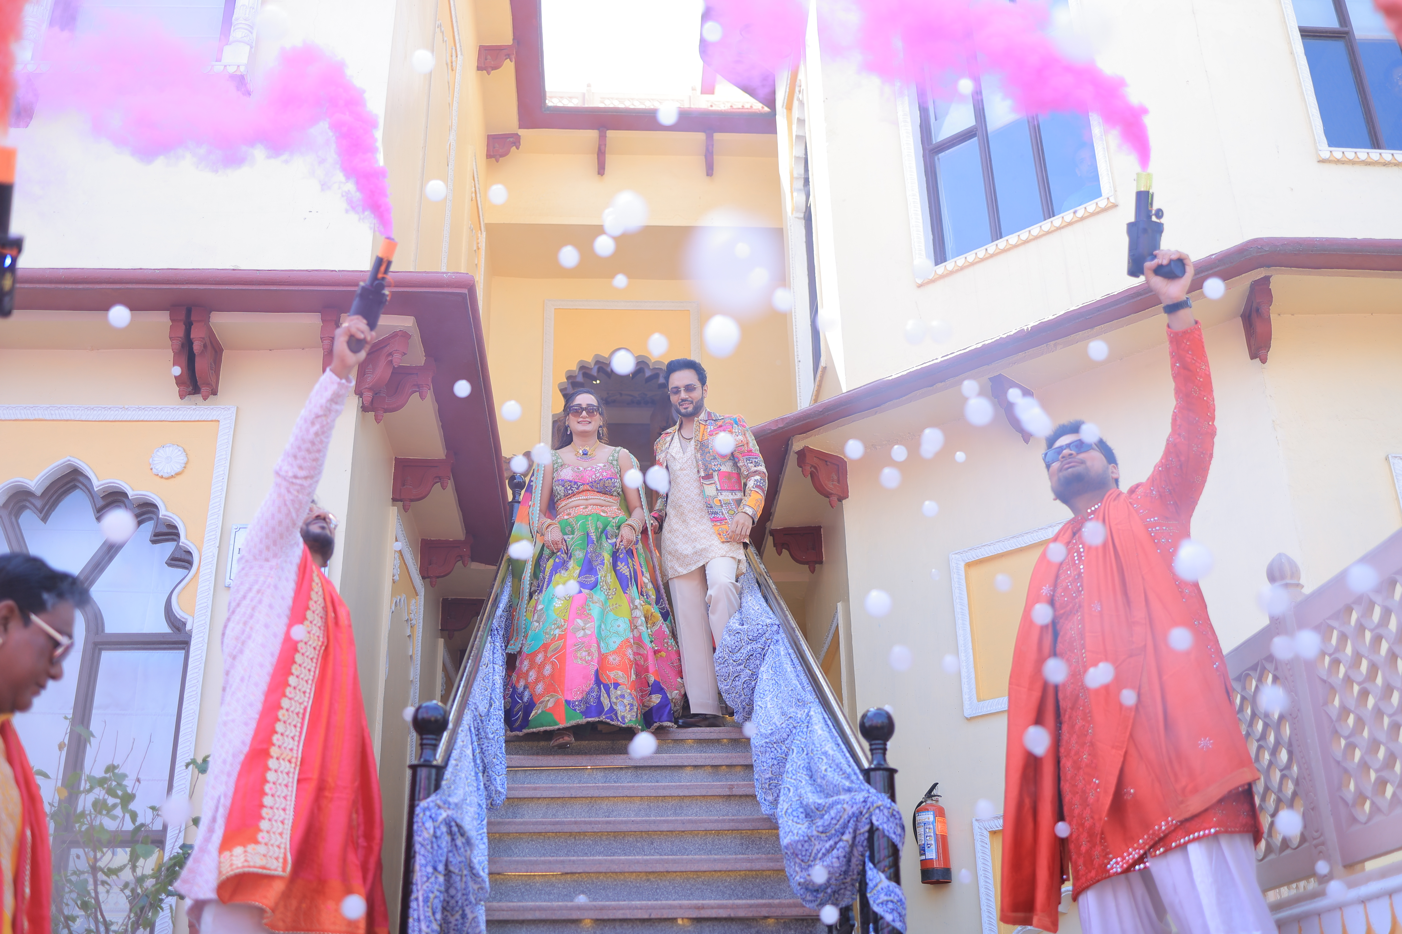
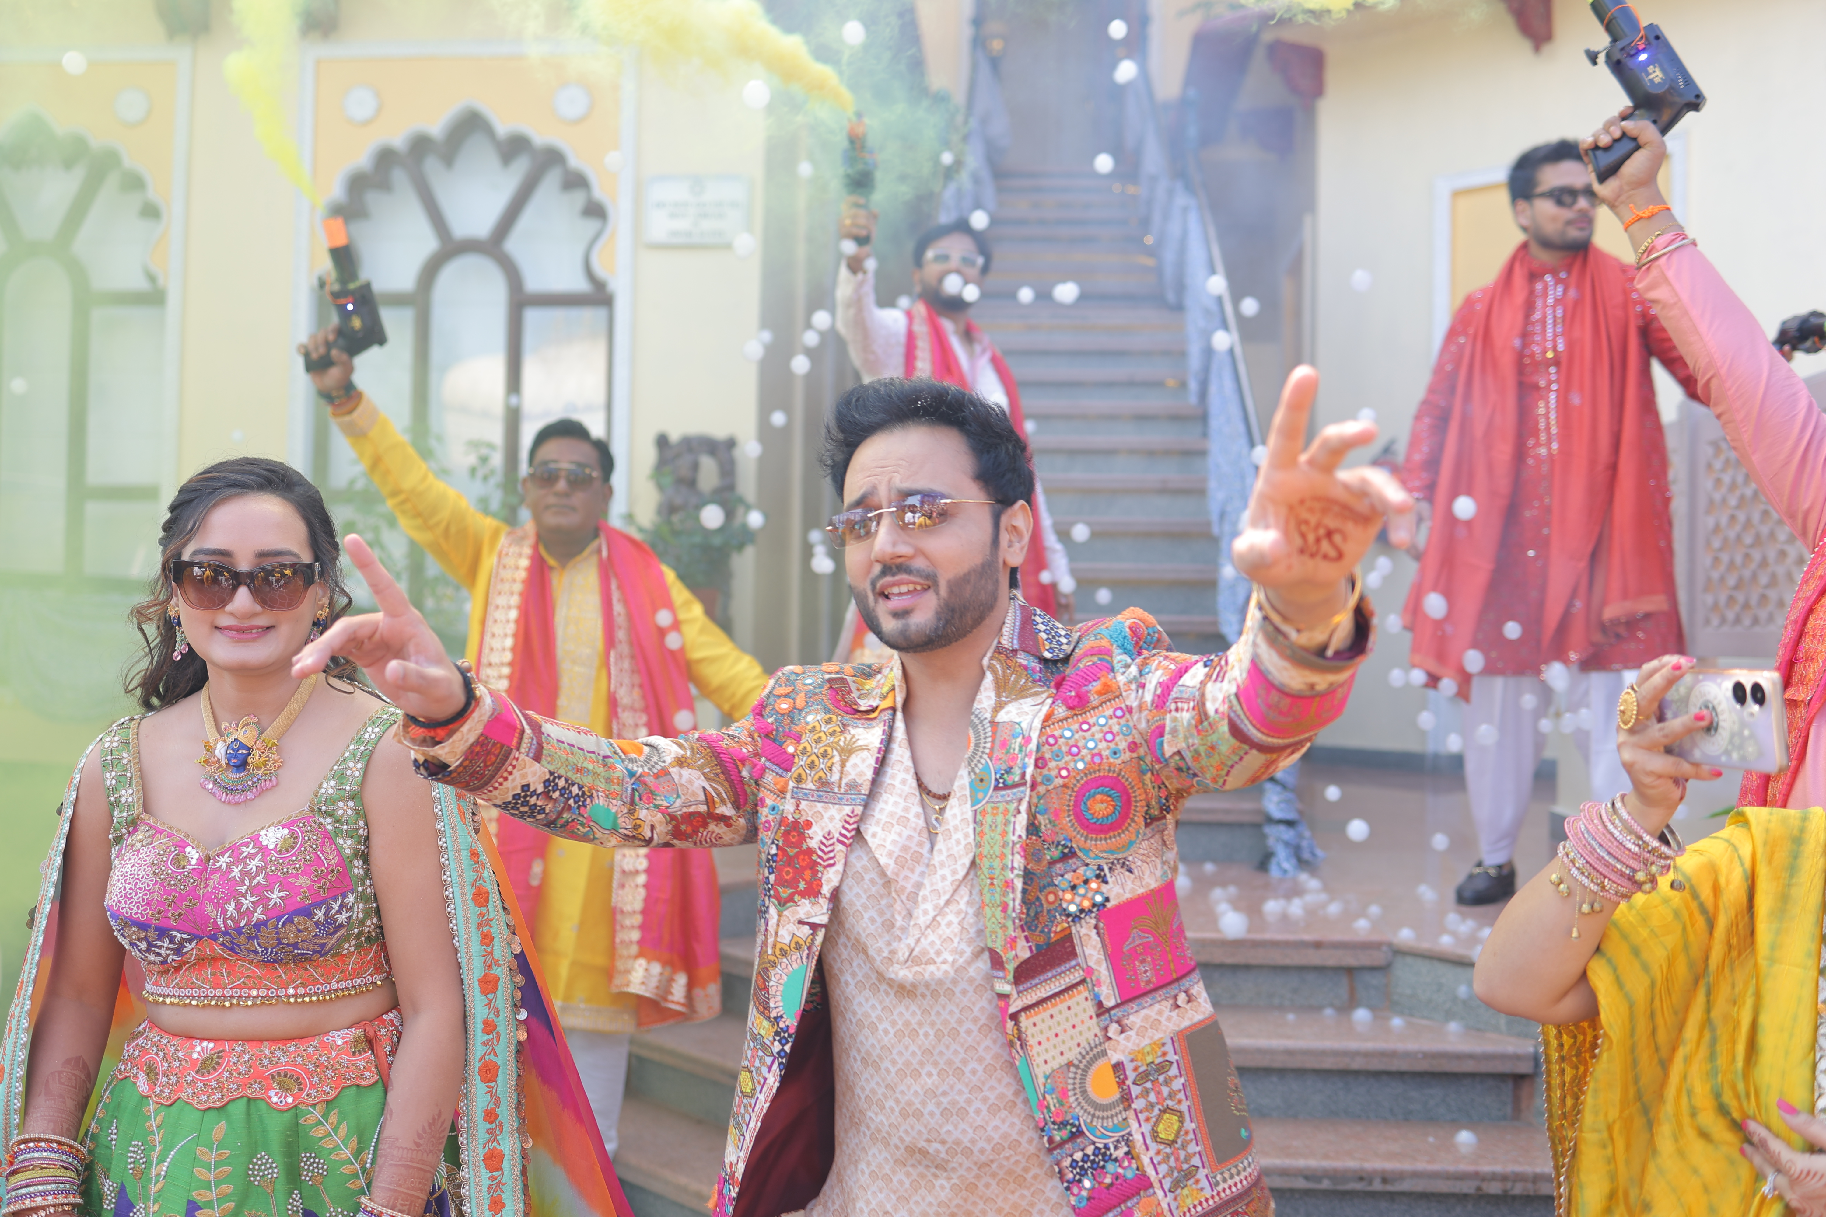
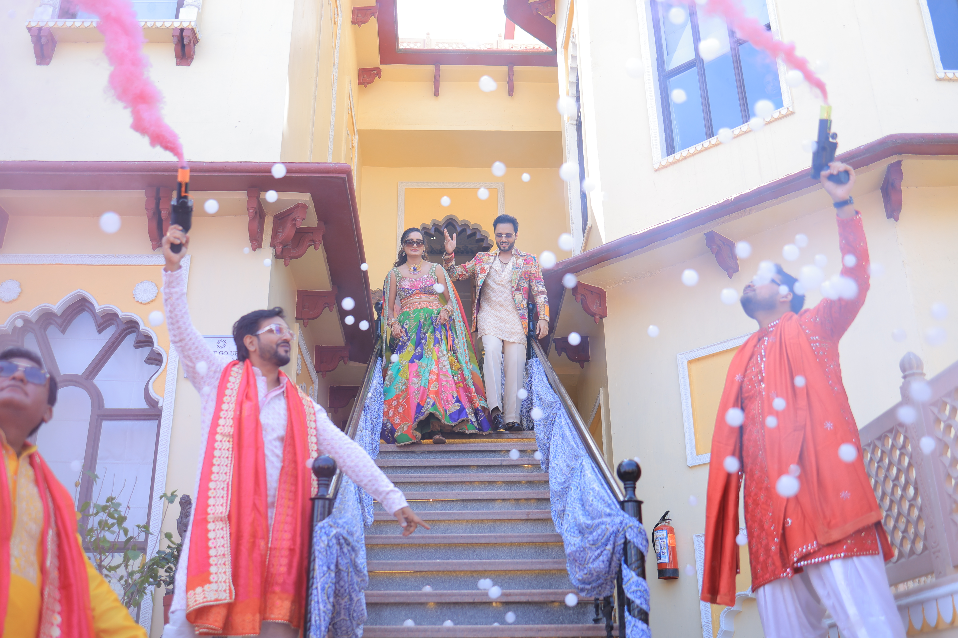

Slide 11
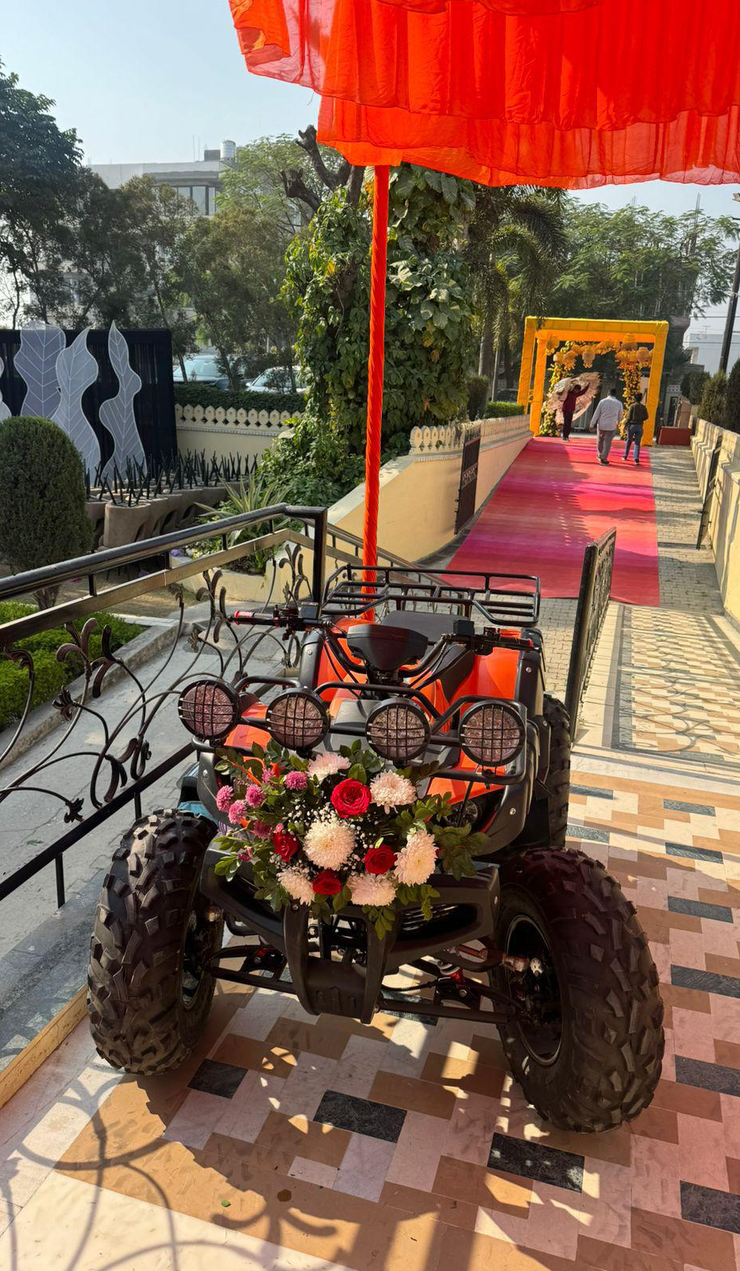
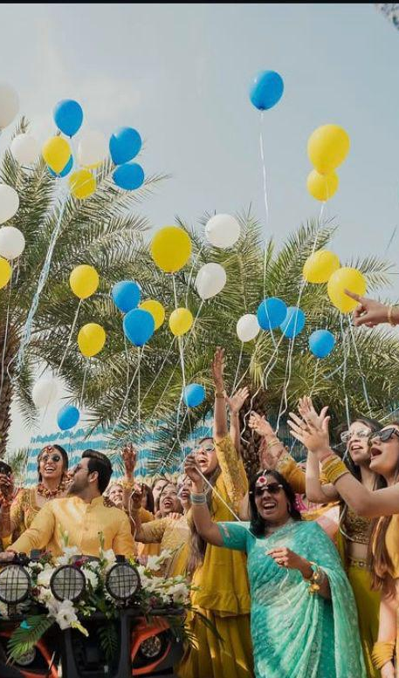
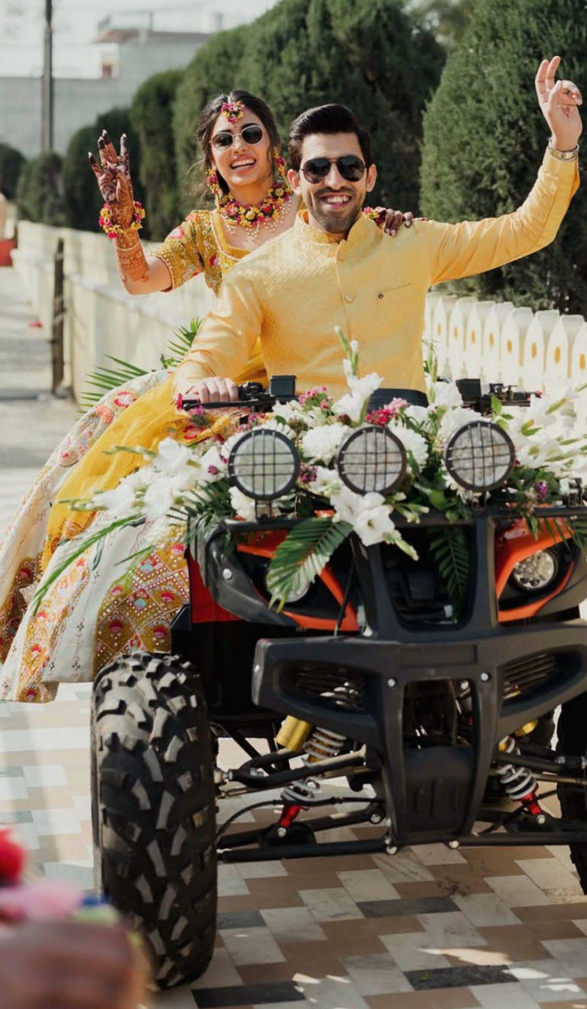

Slide 12
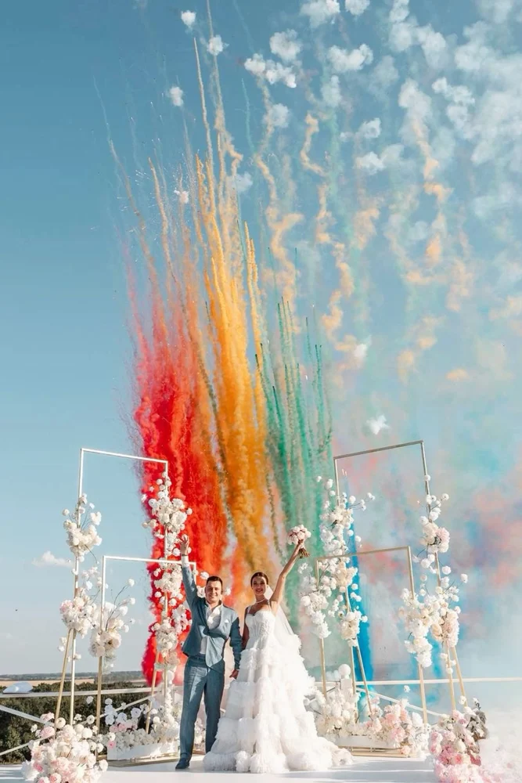
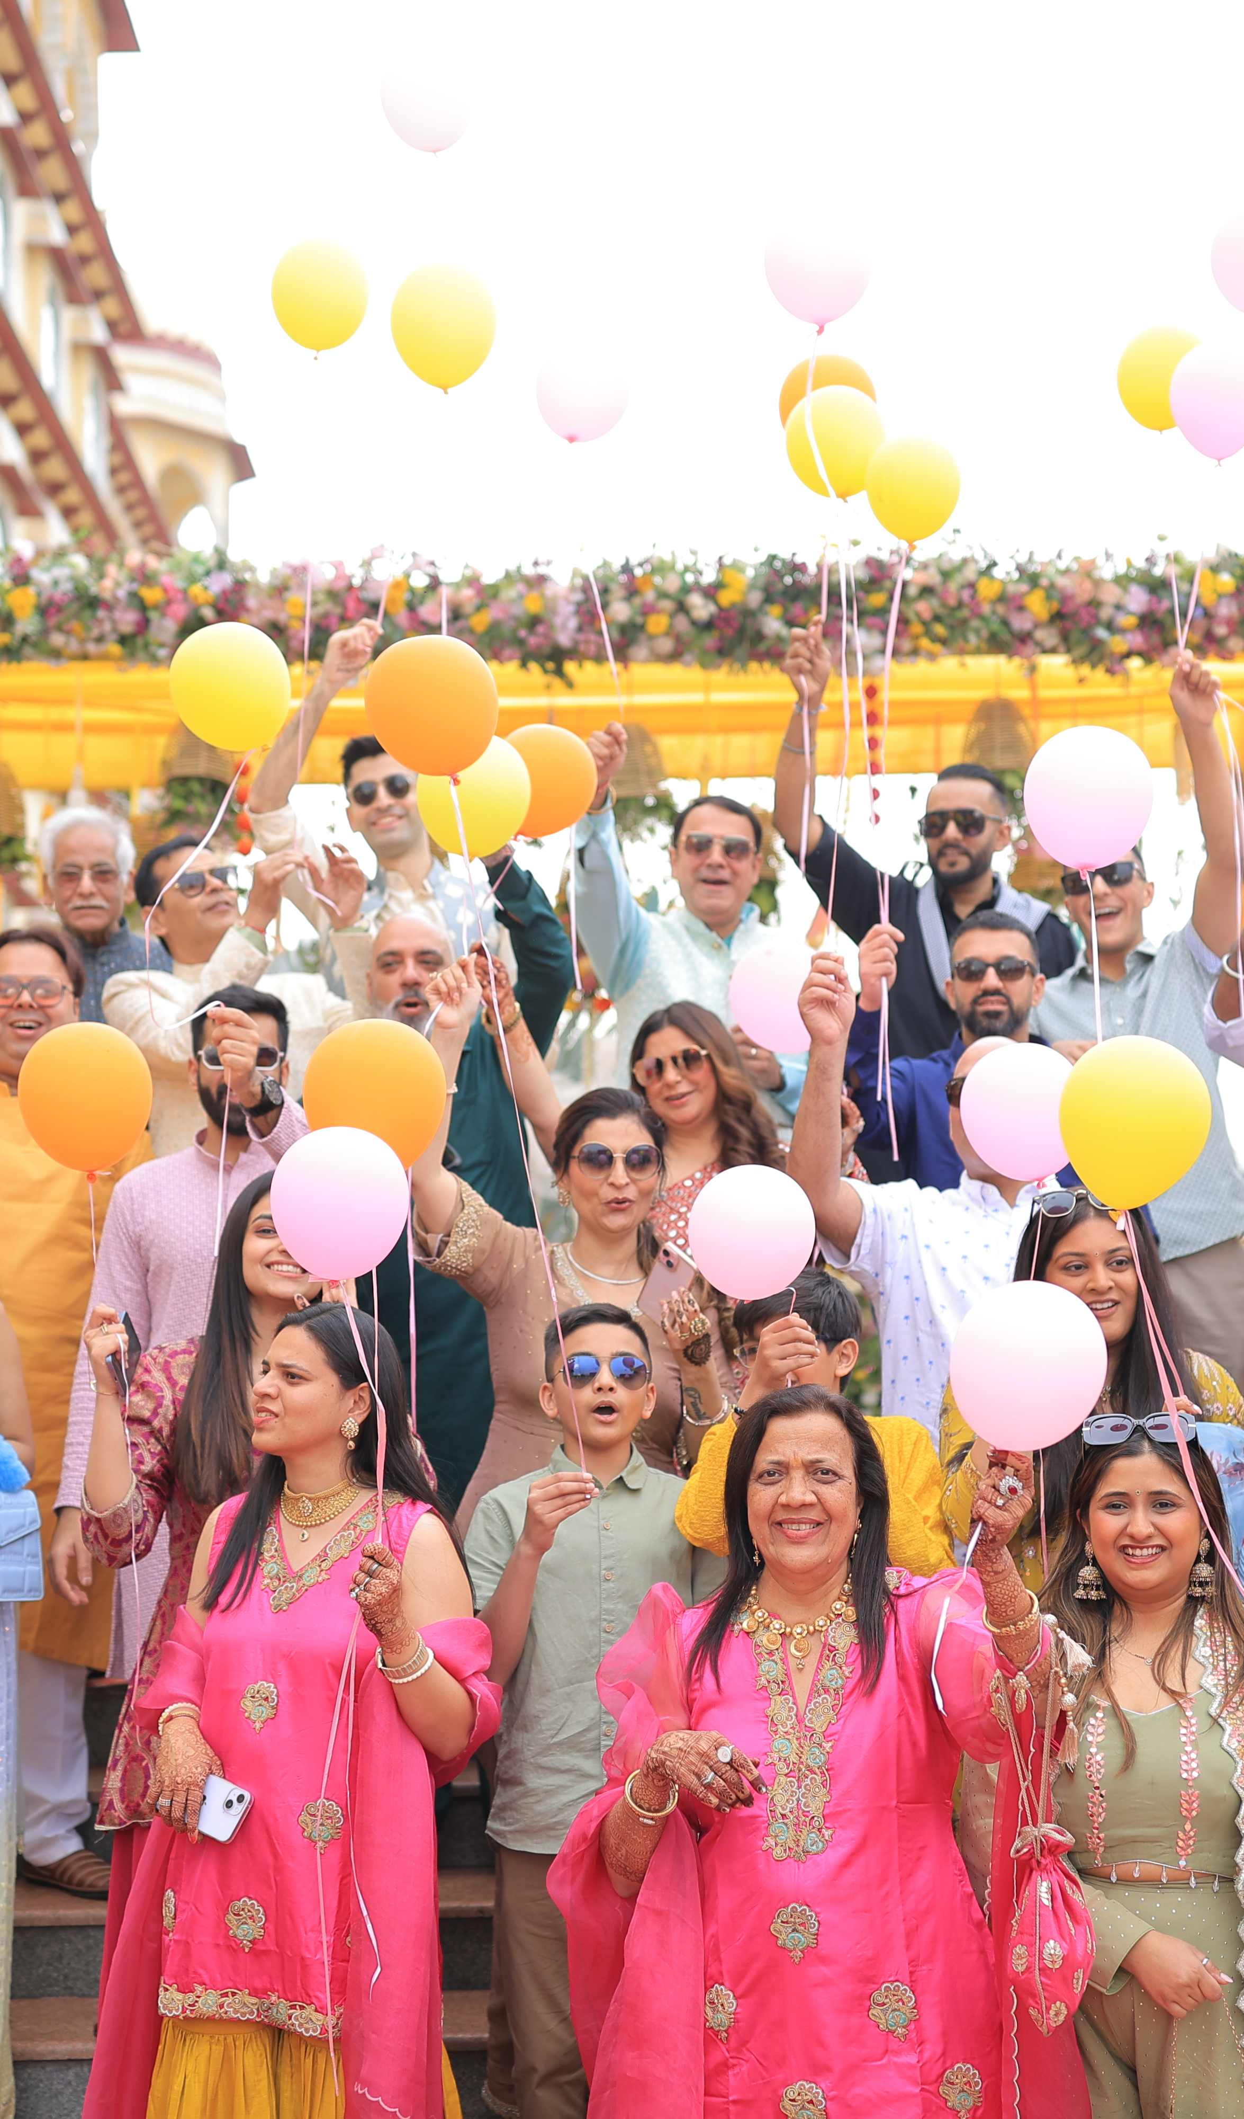
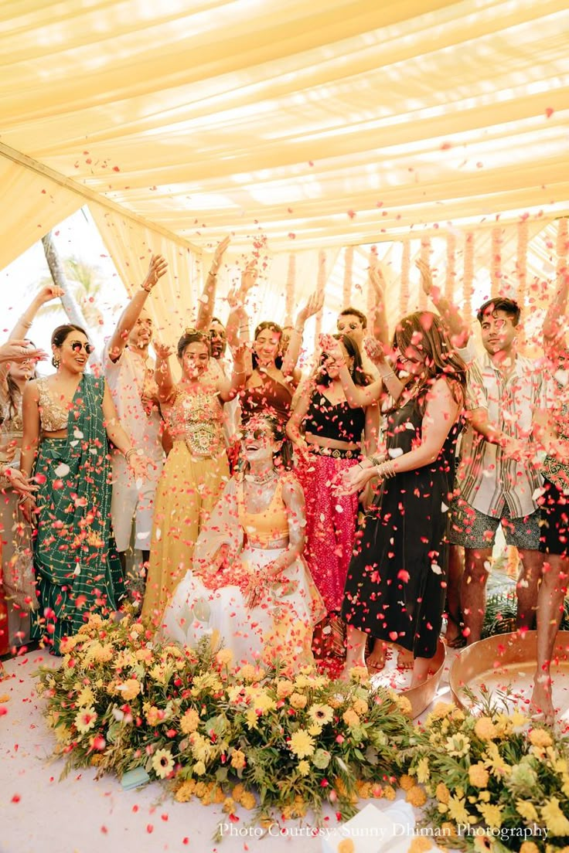

Slide 13
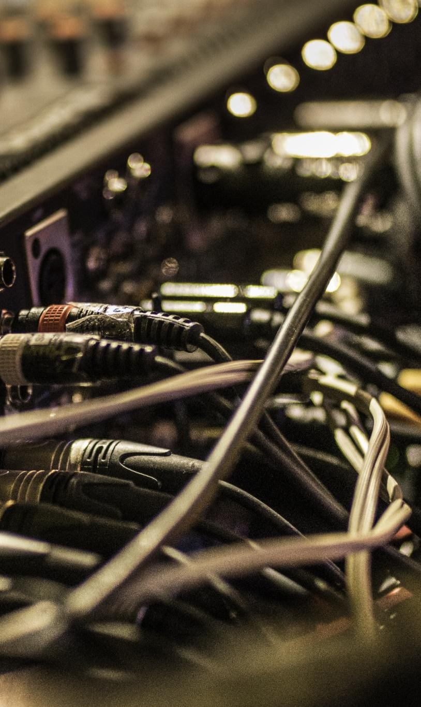
Cocktail Sound Setup
Choosing Speakers
Select speakers that balance volume and clarity to ensure pleasant and clear audio for cocktail events.
Using a Mixer
A mixer helps control audio levels and integrate various sound sources for a seamless audio experience.
Strategic Speaker Positioning
Position speakers strategically to avoid feedback and ensure even sound distribution throughout the venue.
Notes:
A cocktail sound setup ensures clear and pleasant audio for events. First, choose appropriate speakers that balance volume and clarity. Second, use a mixer to control audio levels and integrate various sound sources. Finally, position speakers strategically to avoid feedback and ensure even sound distribution.

Slide 14
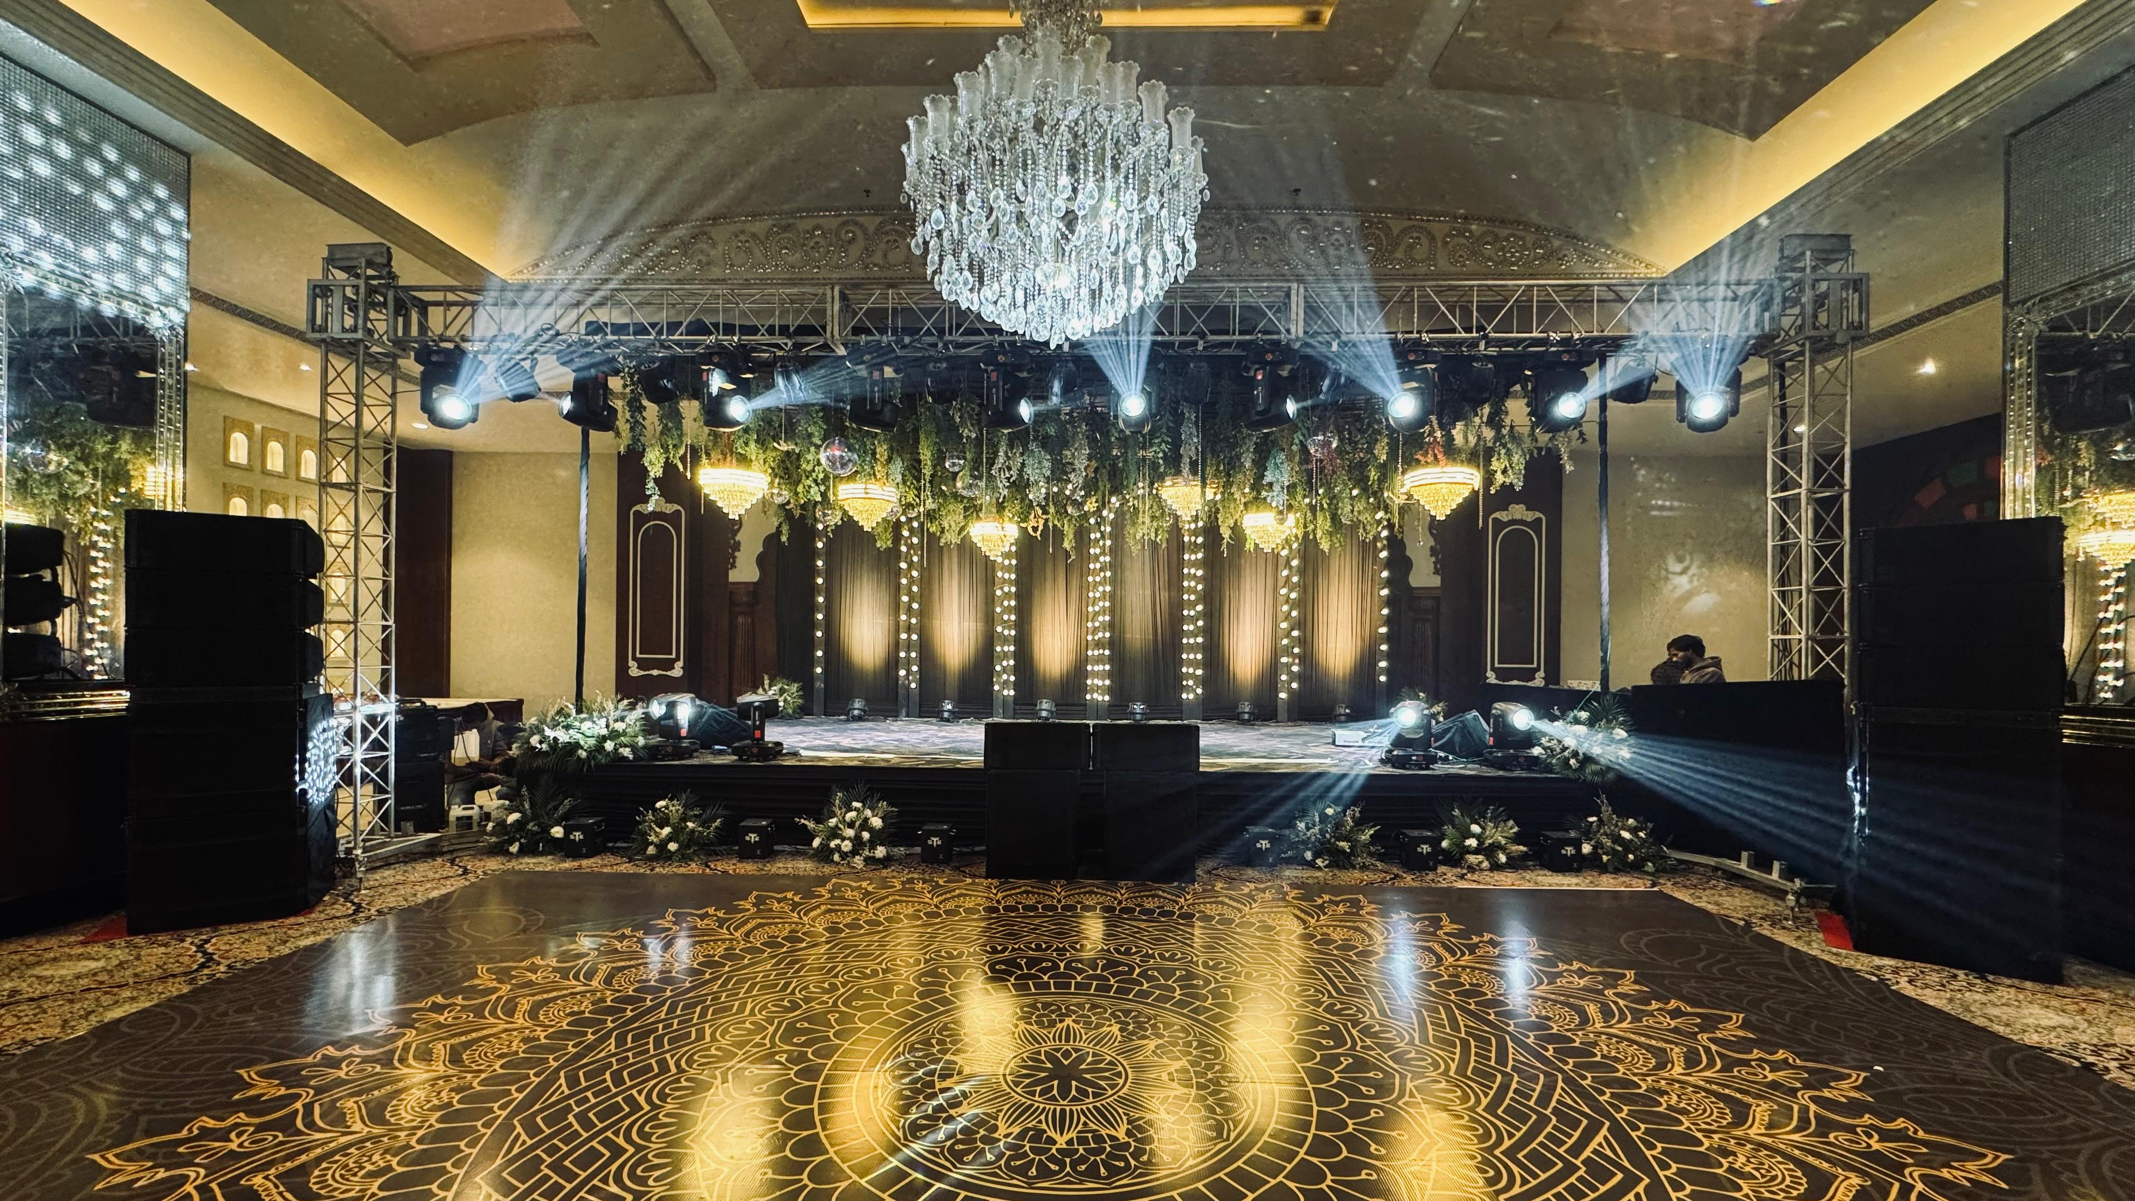

Slide 15
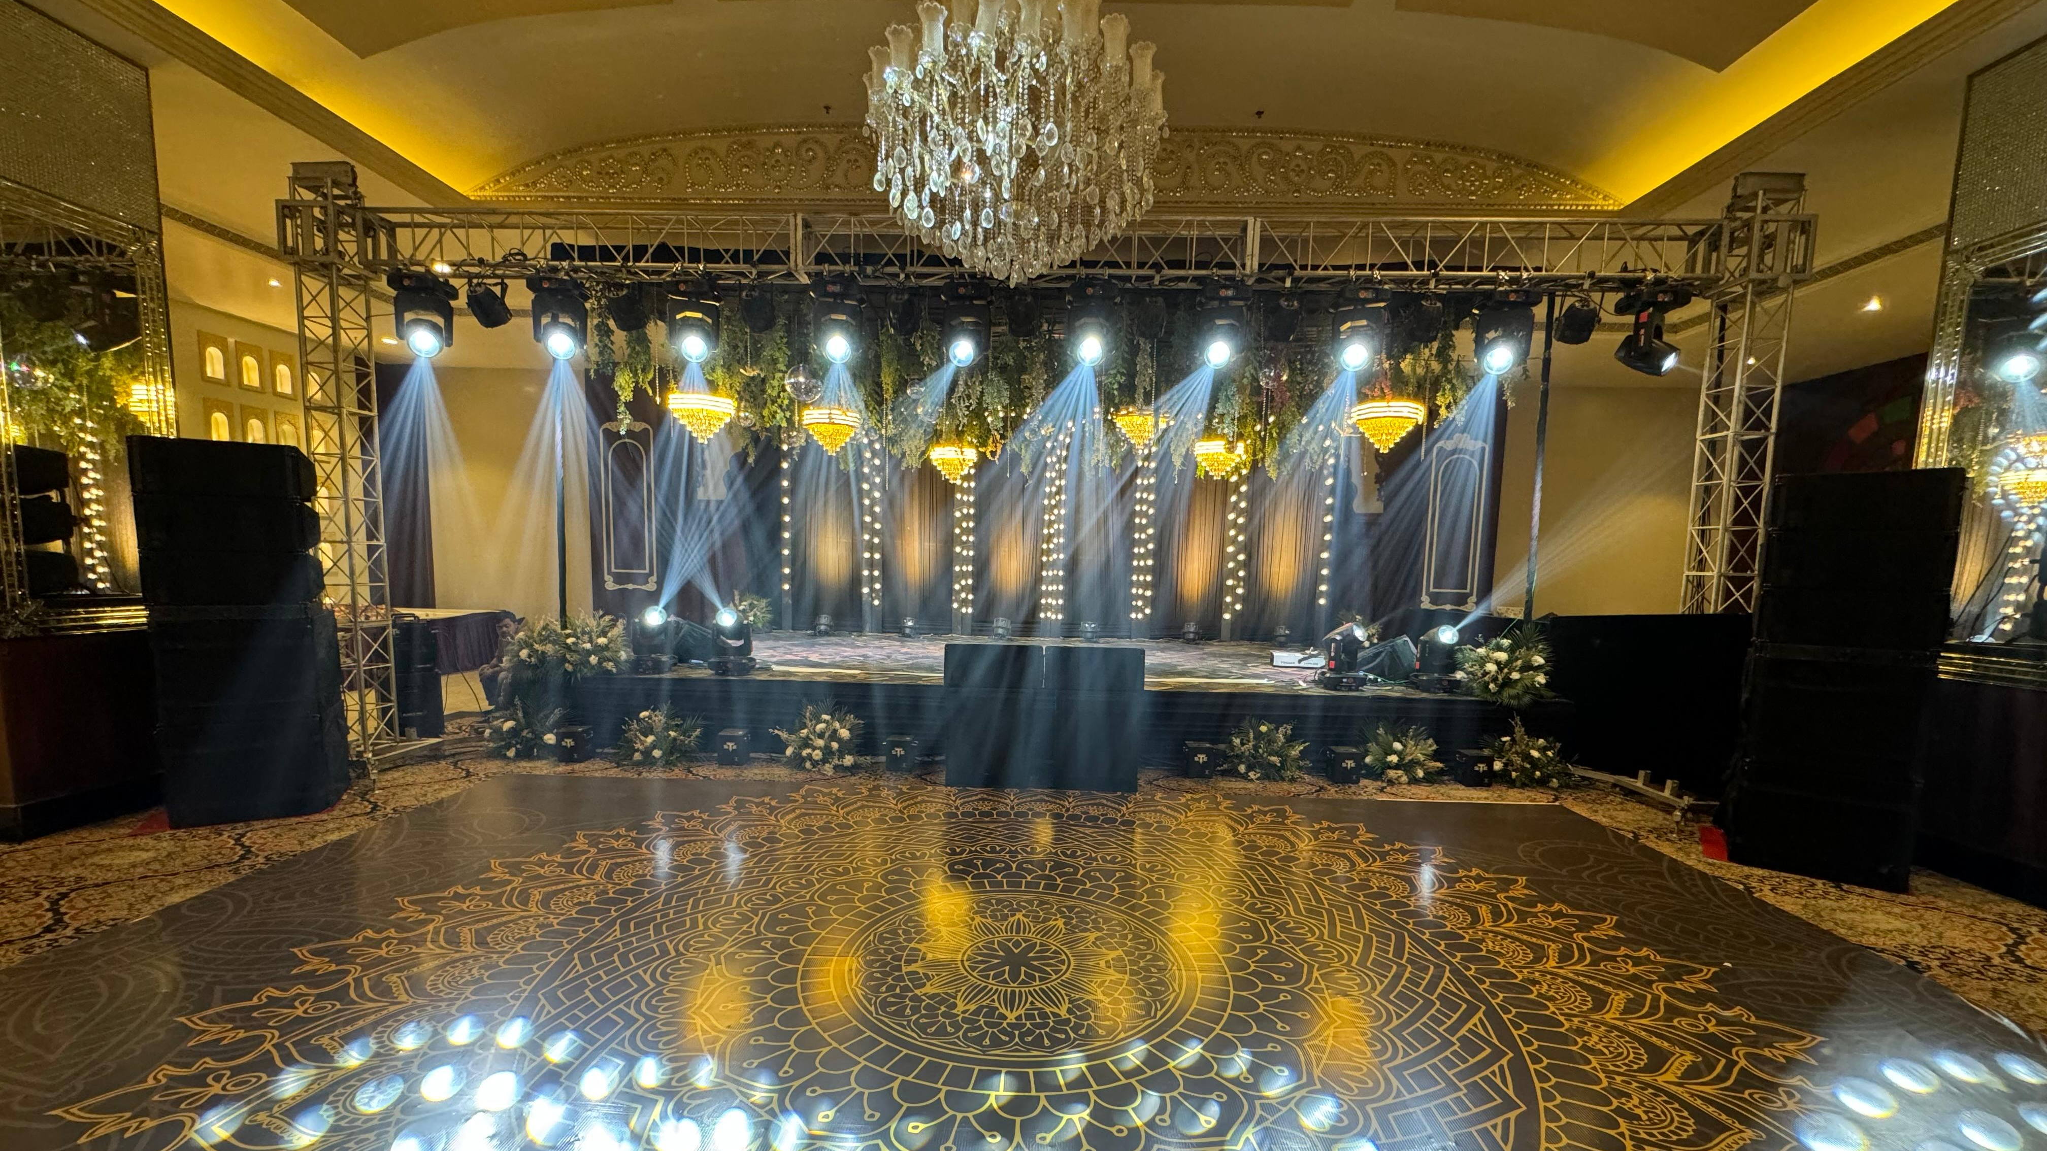

Slide 16
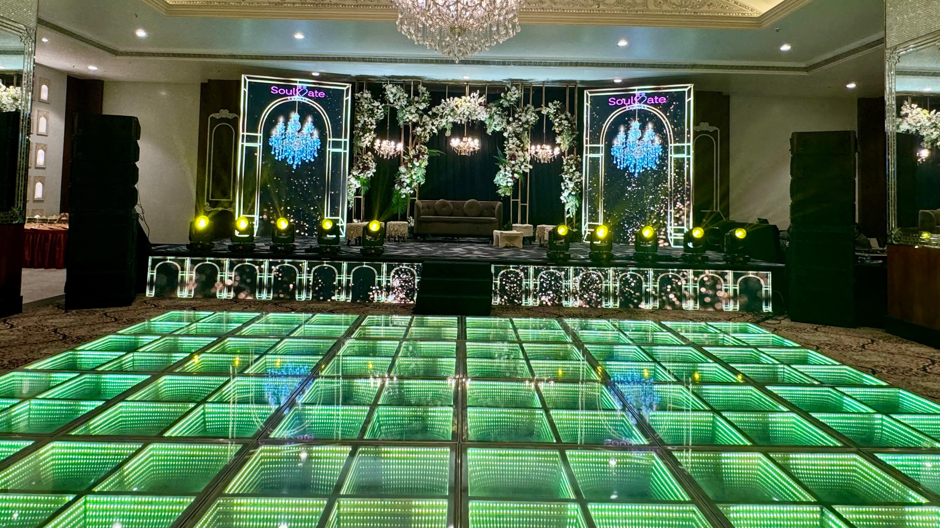

Slide 17
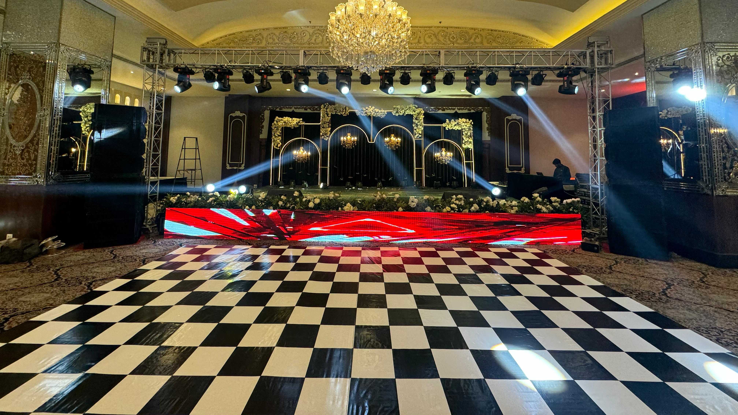

Slide 18
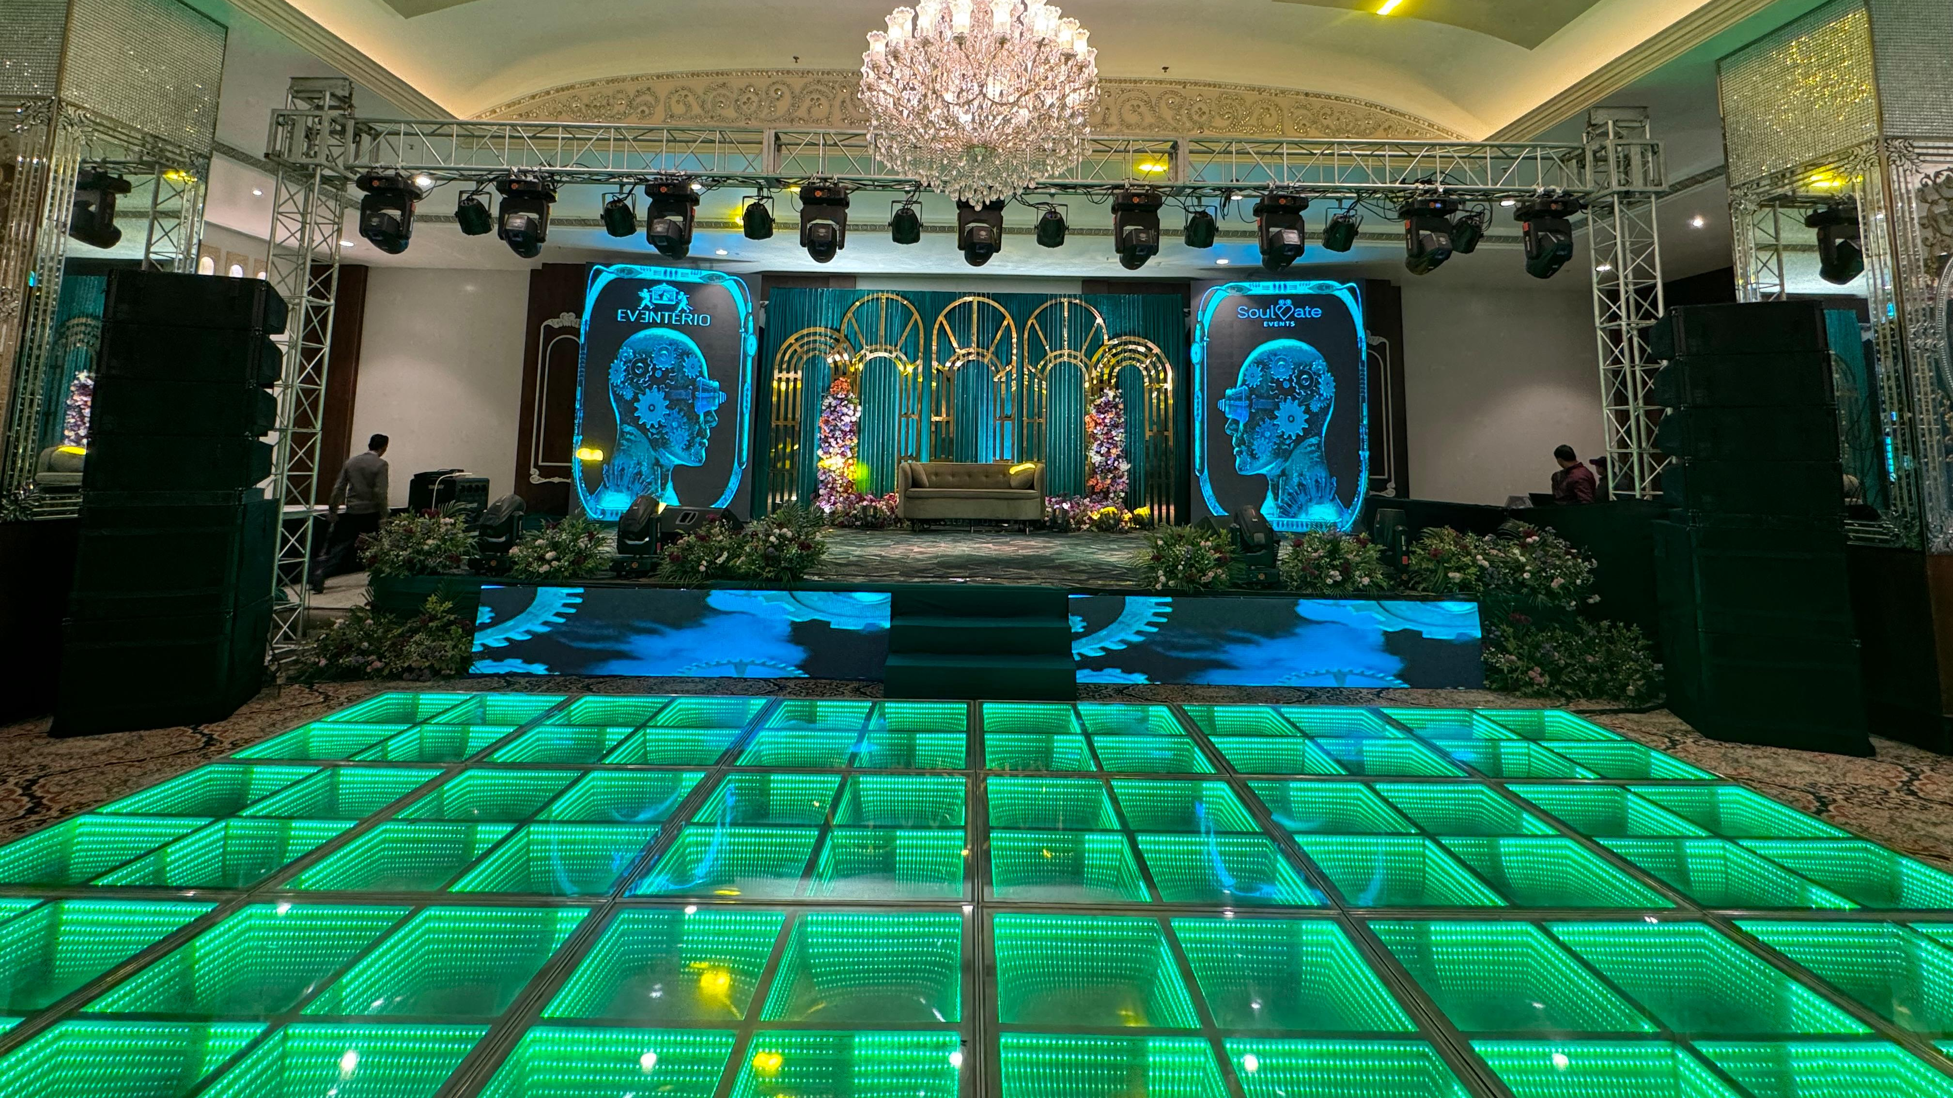

Slide 19
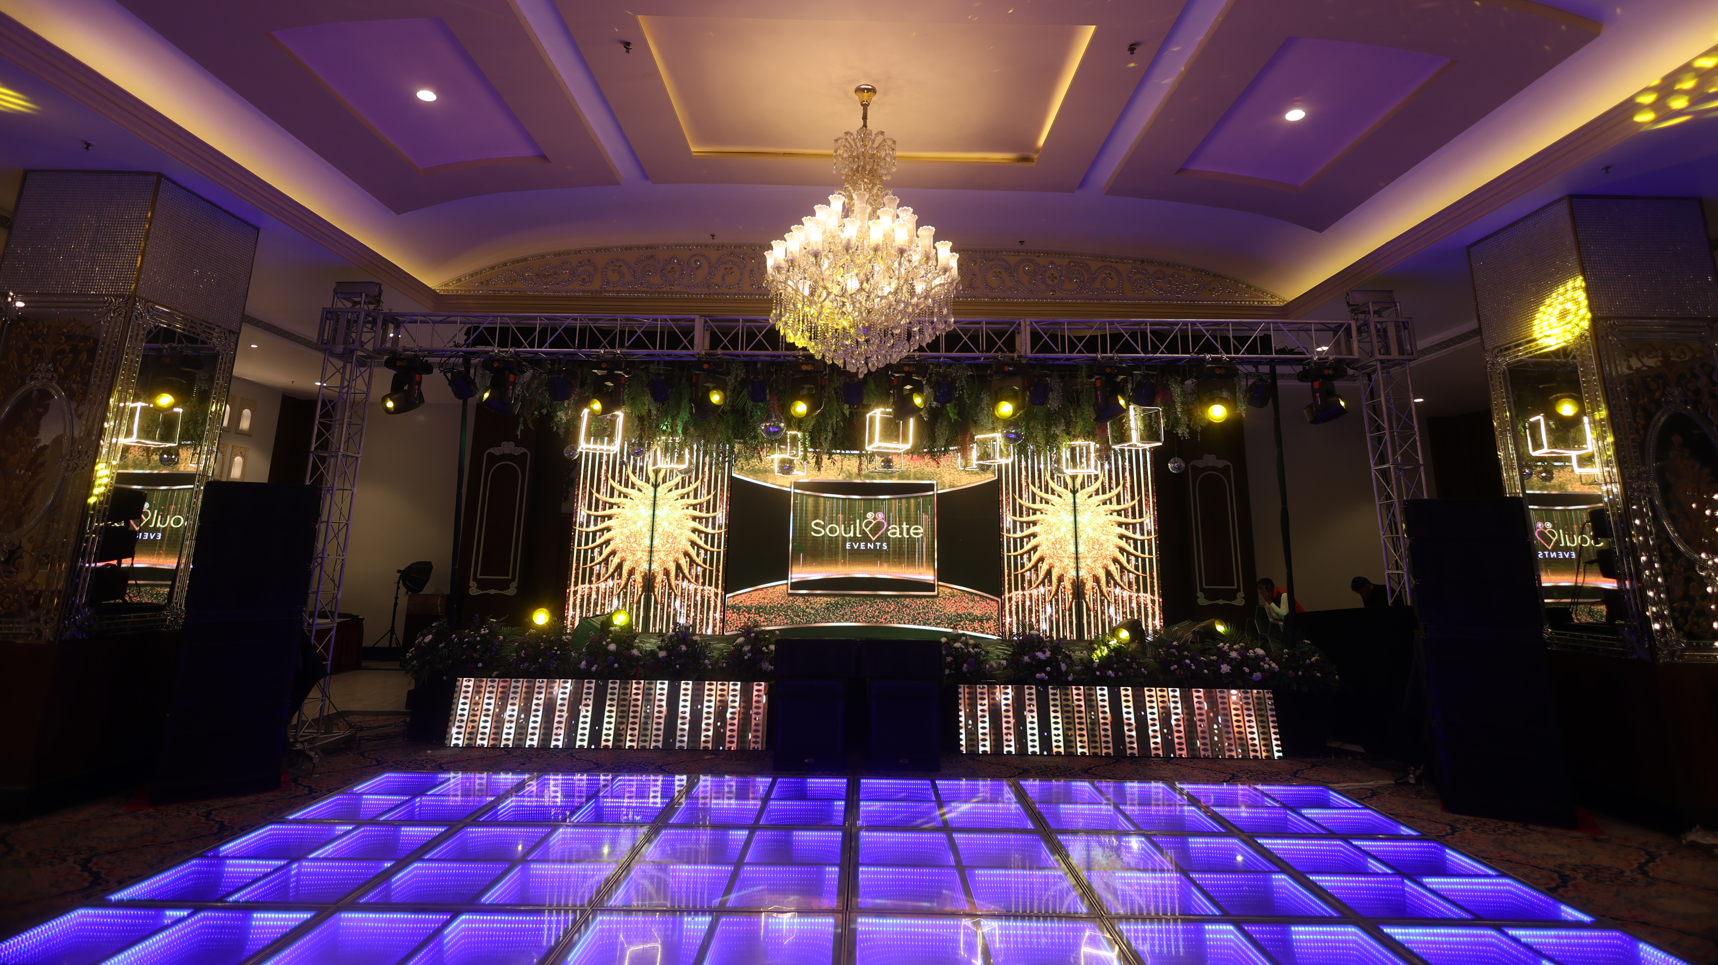

Slide 20
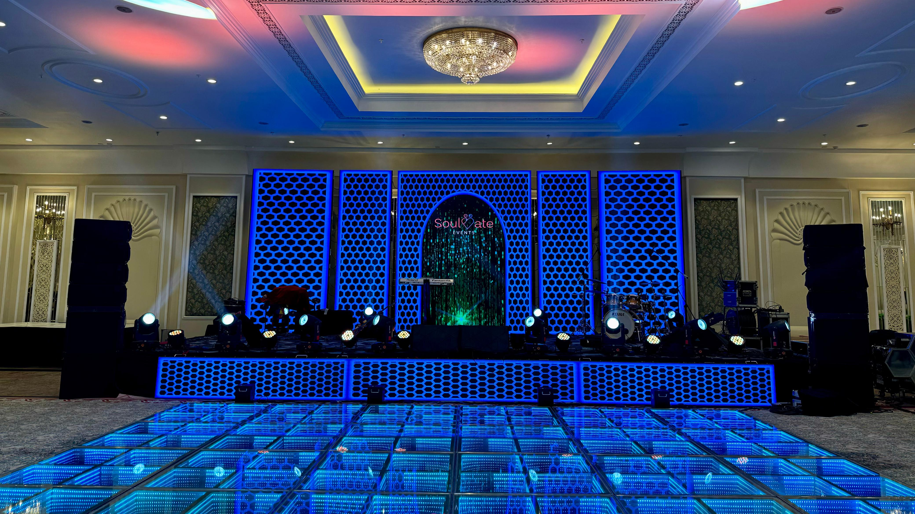

Slide 21
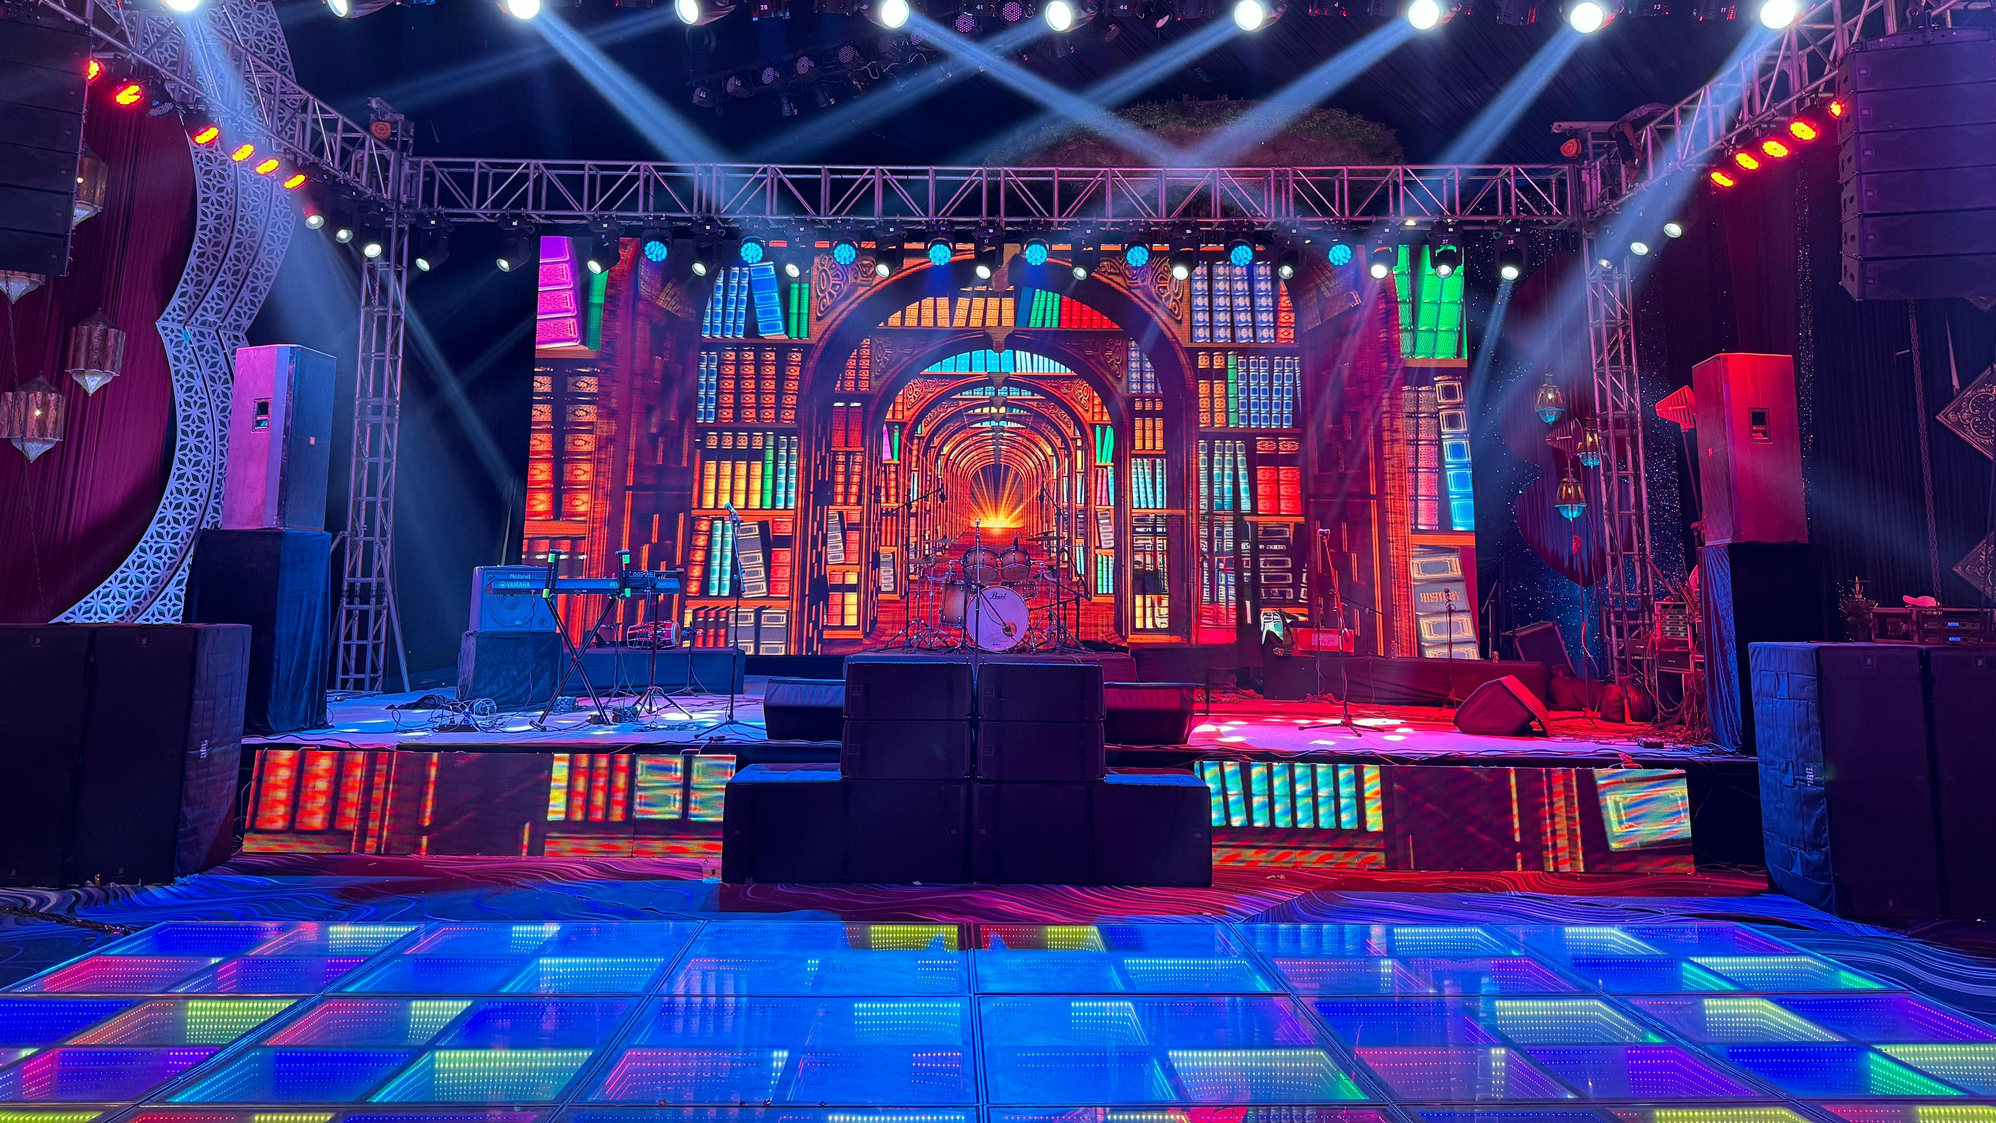

Slide 22
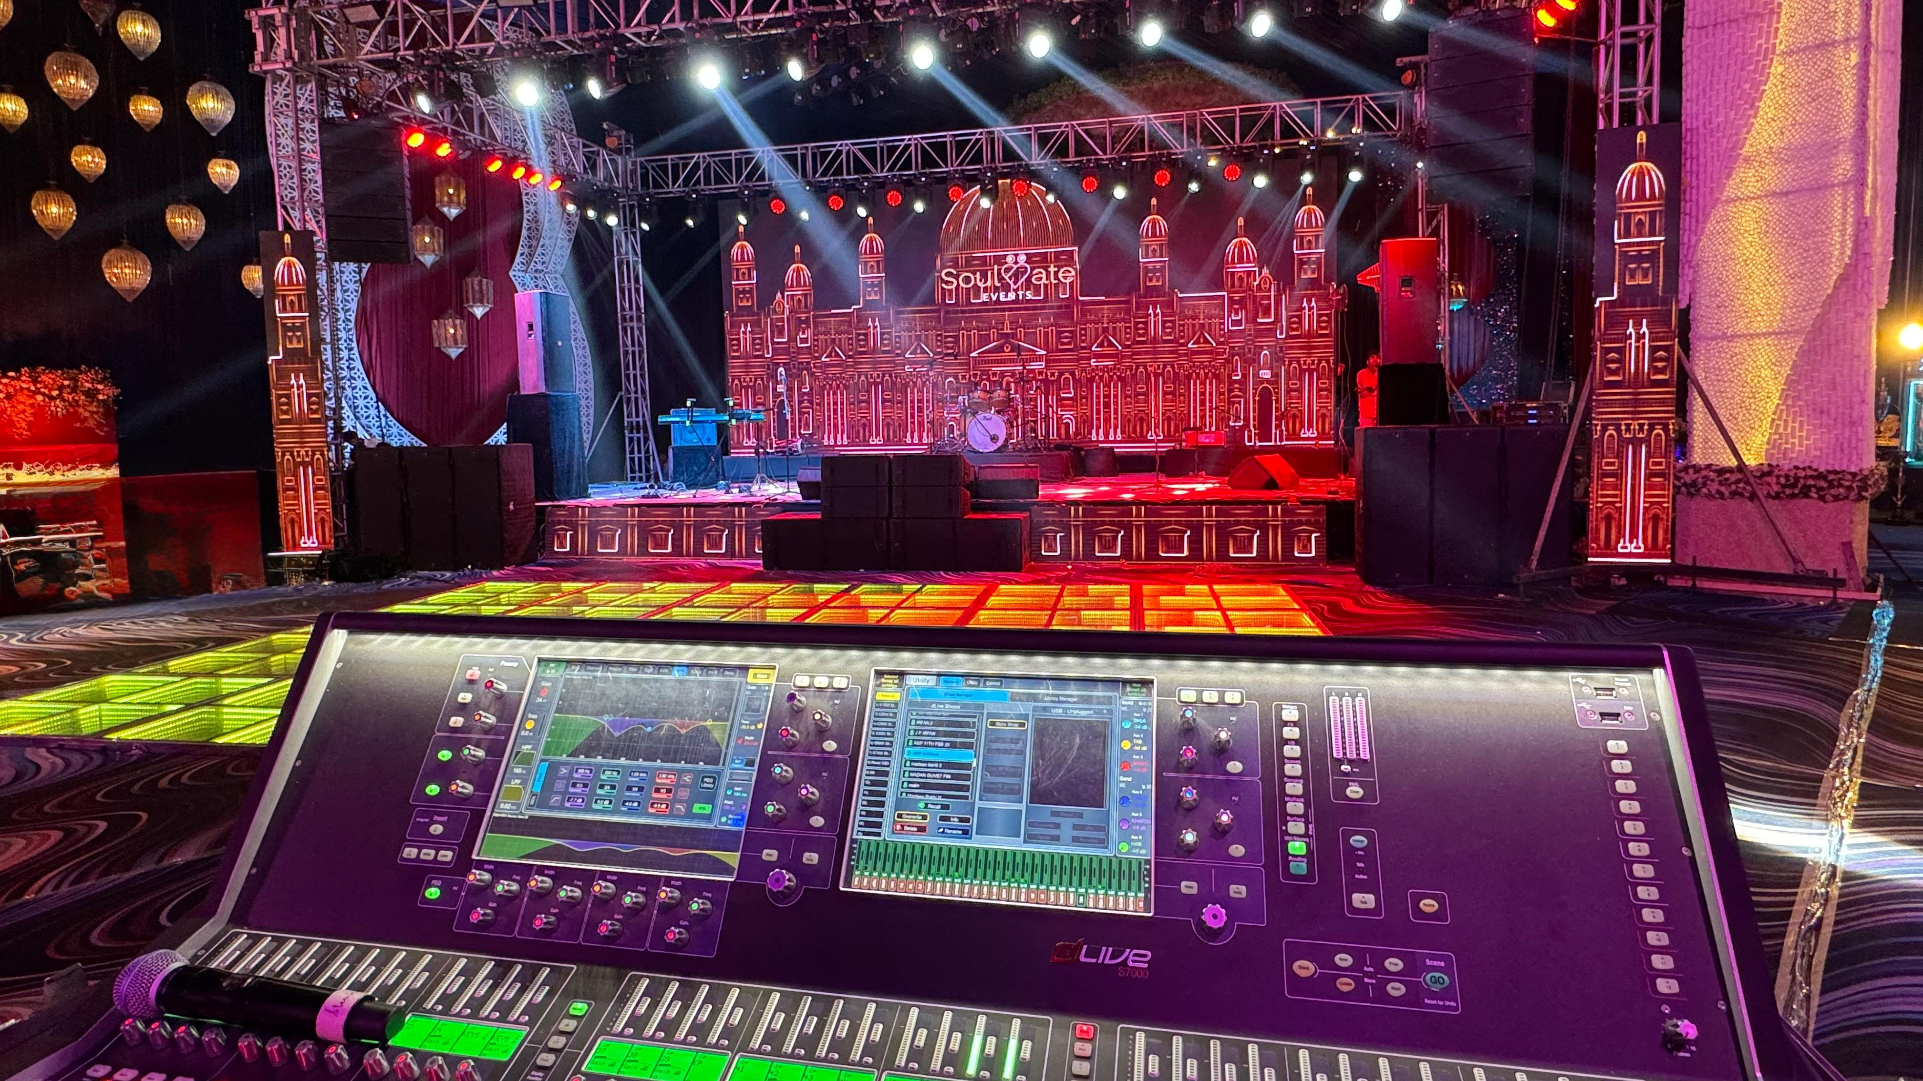

Slide 23
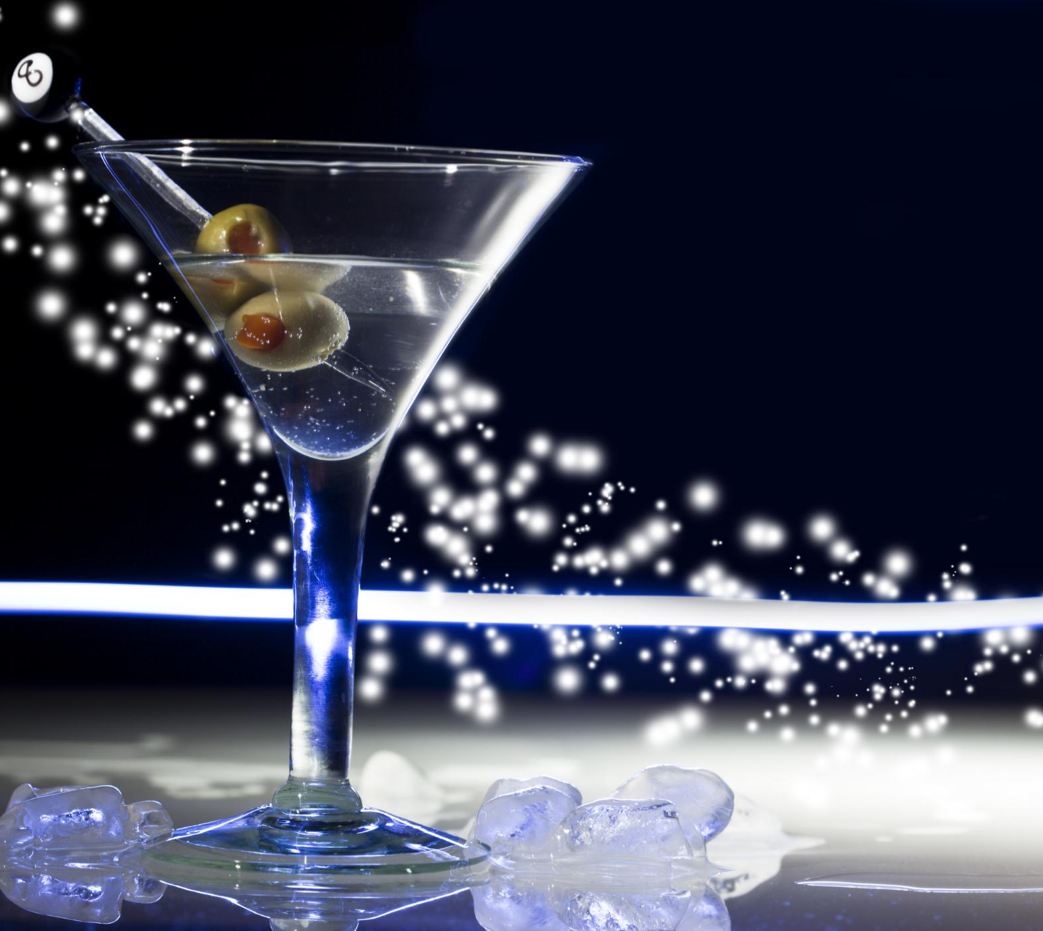
Spectacular Cocktail Effects
Sparkle Machines
Sparkle machines add glittering effects to cocktails, creating a visually stunning experience.
Low Fog Machines
Low fog machines create a mystical ambiance, enhancing the atmosphere of cocktail events.
Pyro Guns
Pyro guns provide dramatic flair with fire effects, making cocktail presentations more exciting.
Bubble Machines
Bubble machines add a playful touch to cocktail events with streams of bubbles.
Co2 Guns & Co2 Jets
Mainly used for performances and enhance the party vibes
Notes:
For special effects in cocktails, various machines and devices can be used to create an unforgettable experience. Sparkle machines add glittering effects, while low fog machines create a mystical ambiance. Pyro guns can be used for dramatic flair, and bubble machines add a playful touch. Laser lights create stunning visuals, and confetti showers add a celebratory feel to any cocktail event.

Slide 24
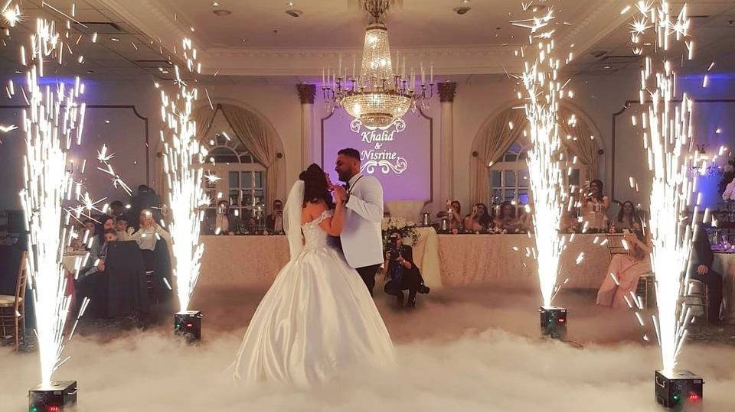

Slide 25
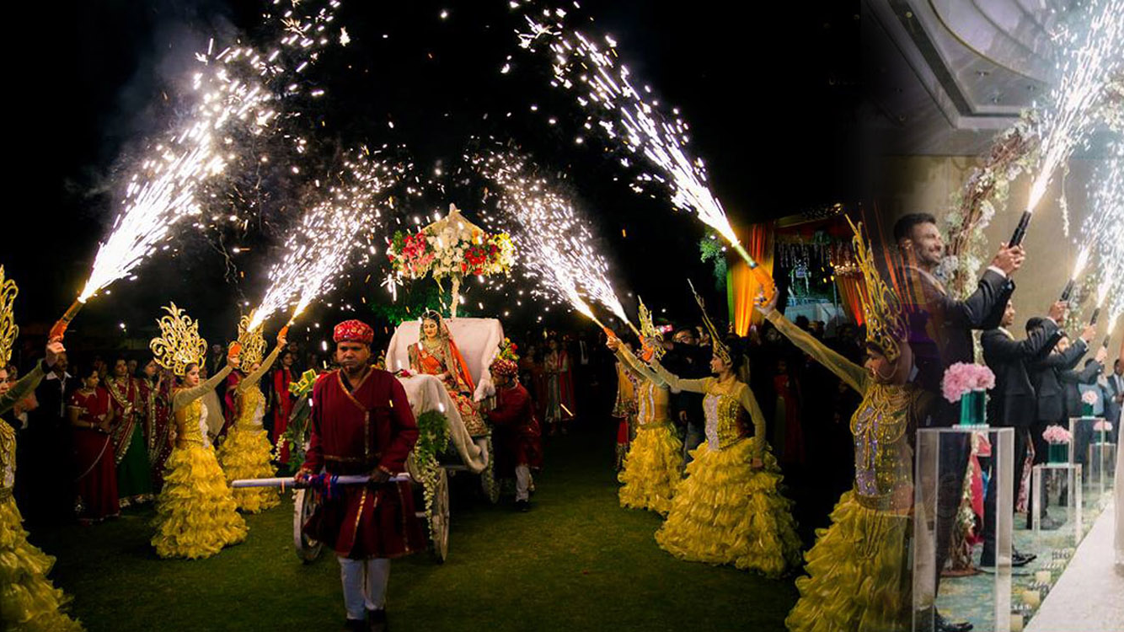

Slide 26
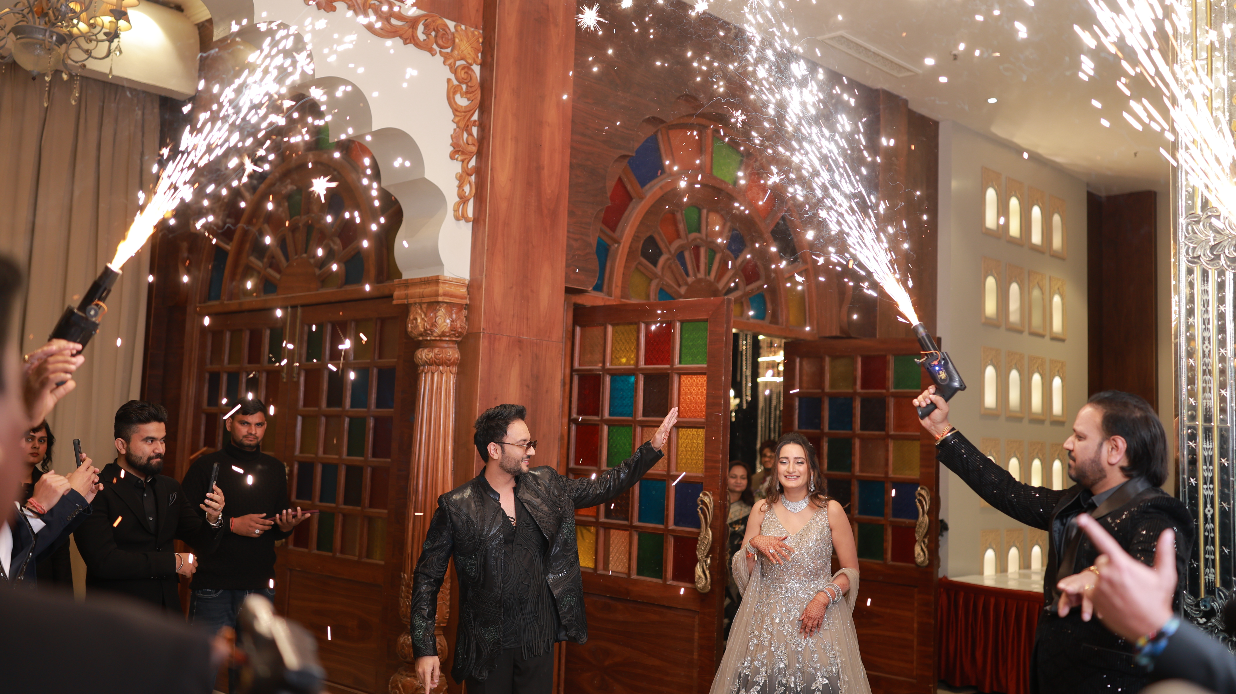

Slide 27
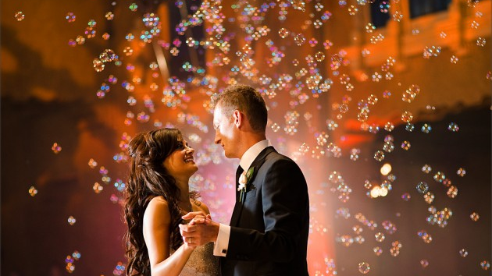

Slide 28
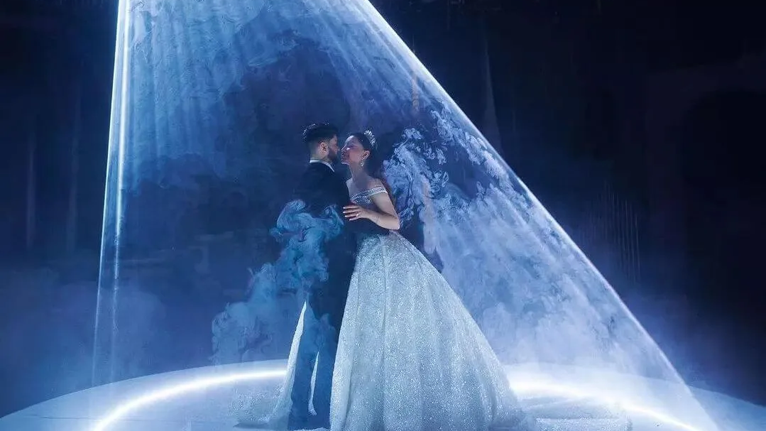

Slide 29
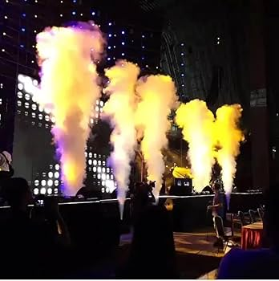
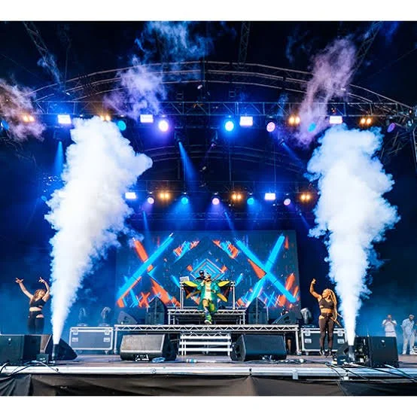
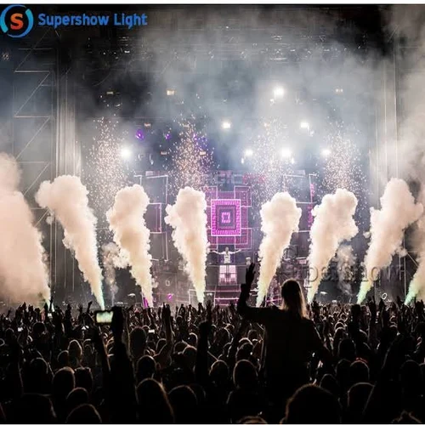

Slide 30
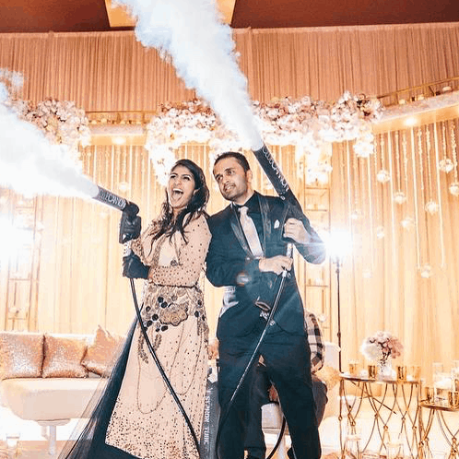
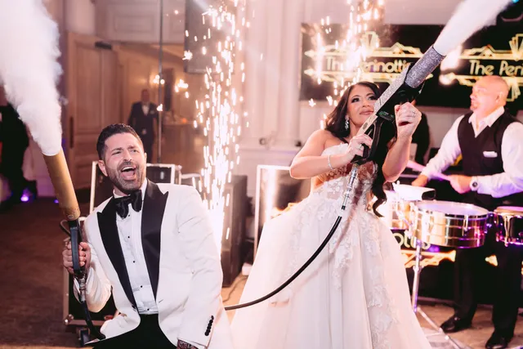
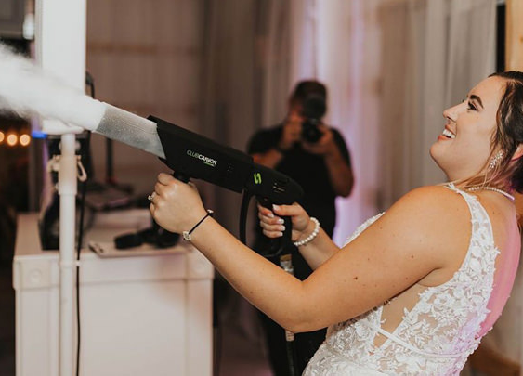

Slide 31
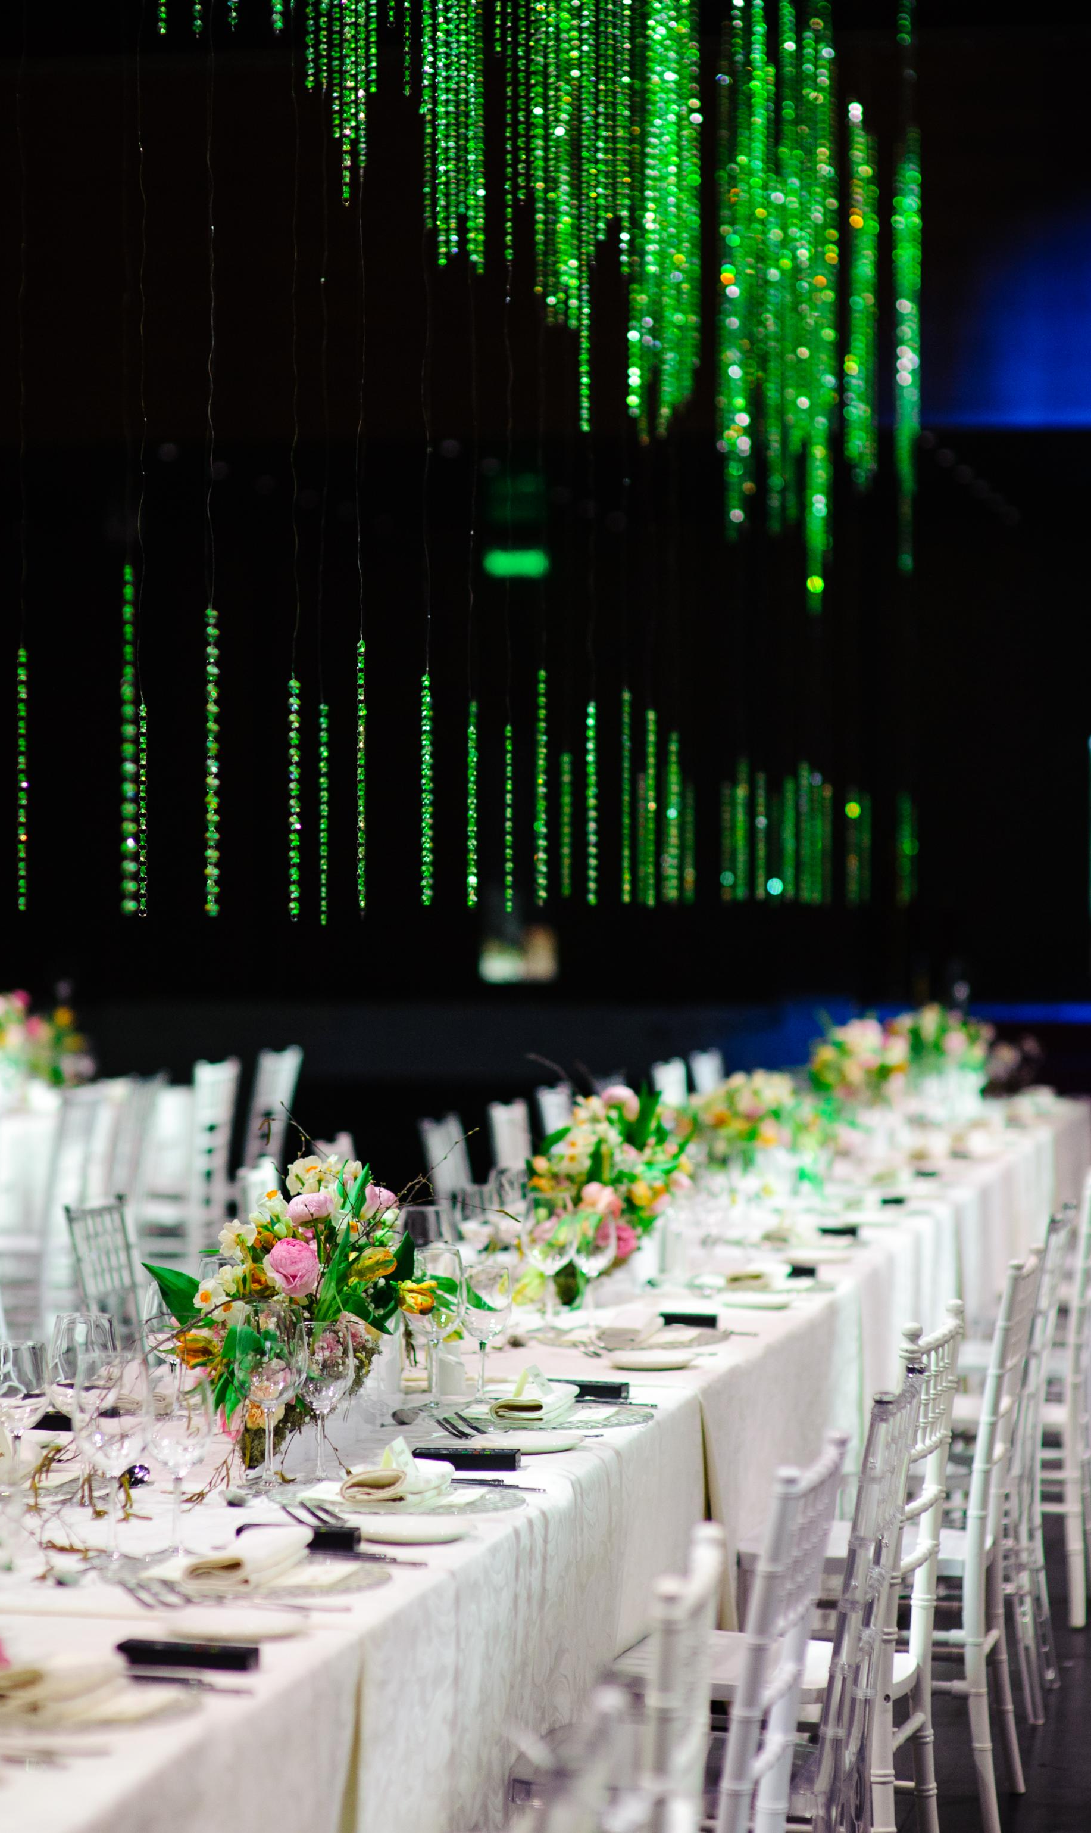
Wedding Setup with LED Screen
Stunning Visual Impact
LED screens create a stunning visual impact for weddings by providing dynamic backdrops and personalized displays.
Versatile Displays
LED screens can showcase live video feeds, photo slideshows, and custom graphics, enhancing the overall ambiance.
Adaptable to Themes
LED screens are versatile and can be adapted to fit various themes and styles, making them perfect for modern weddings.
Notes:
Using LED screens in wedding setups has become increasingly popular. They offer a stunning visual impact, allowing for dynamic backdrops and personalized displays. LED screens can showcase live video feeds, photo slideshows, and custom graphics, enhancing the overall ambiance. They are versatile, easy to set up, and can be adapted to fit various themes and styles, making them a perfect addition to modern weddings.

Slide 33
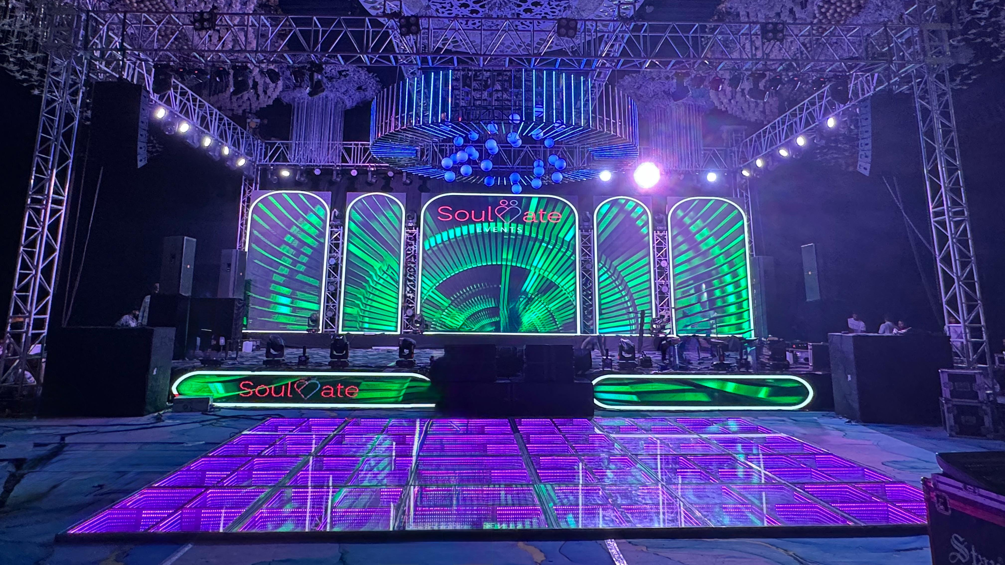

Slide 34
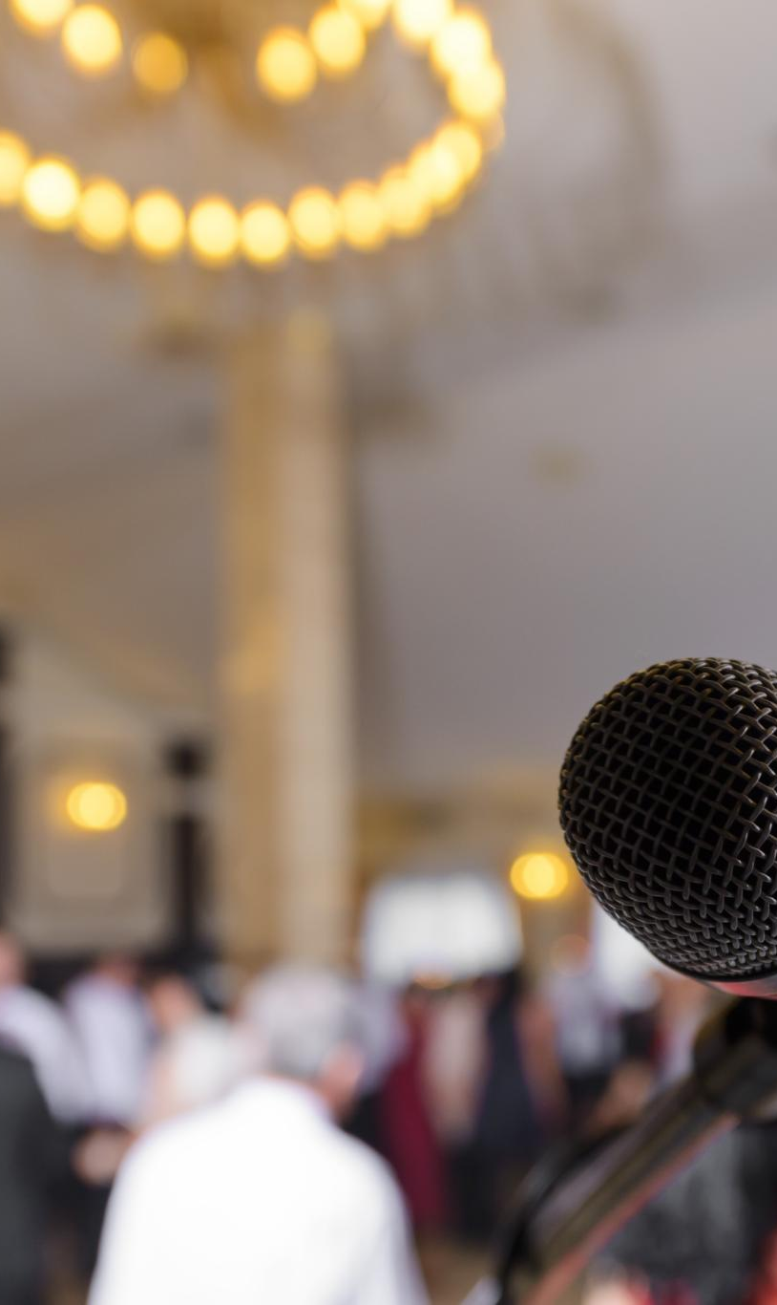
Wedding Day Sound Setup
Flex Floor Utilization
Using a flex floor allows for adaptable speaker placements, ensuring optimal sound quality throughout the venue.
High-Quality Microphones
High-quality microphones are essential for clear audio, ensuring that every word from the ceremony is heard by guests.
Strategic Speaker Placement
Strategically placed speakers ensure even sound distribution throughout the venue, enhancing the auditory experience for all guests.
Skilled Sound Technicians
Skilled sound technicians manage audio levels, ensuring that every detail of the ceremony and reception is heard clearly.
Notes:
A perfect wedding day relies on a flawless sound setup. Utilizing a flex floor allows for customizable and adaptable speaker placements, ensuring optimal sound quality throughout the venue. Key components include high-quality microphones, strategically placed speakers, and skilled sound technicians to manage audio levels, ensuring every word and note is heard clearly by guests.

Slide 35
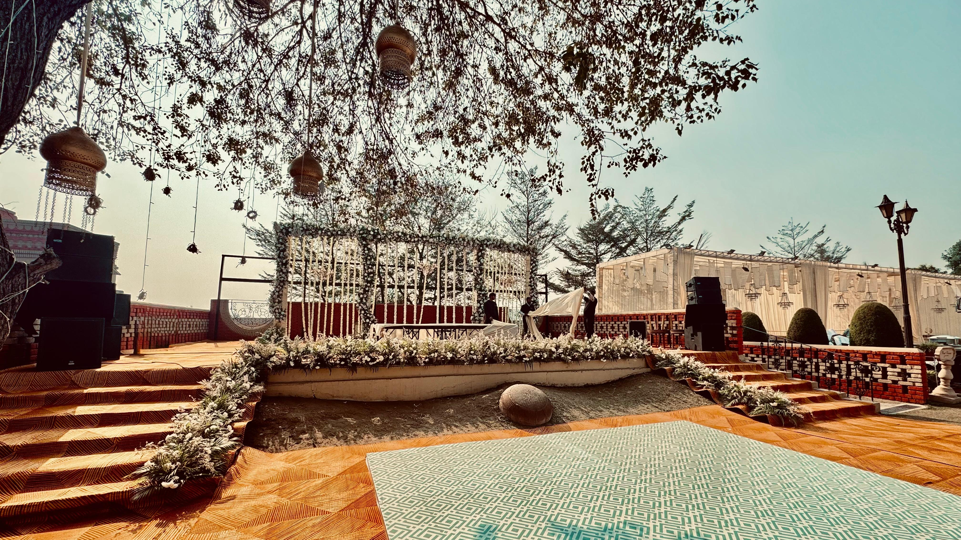

Slide 36
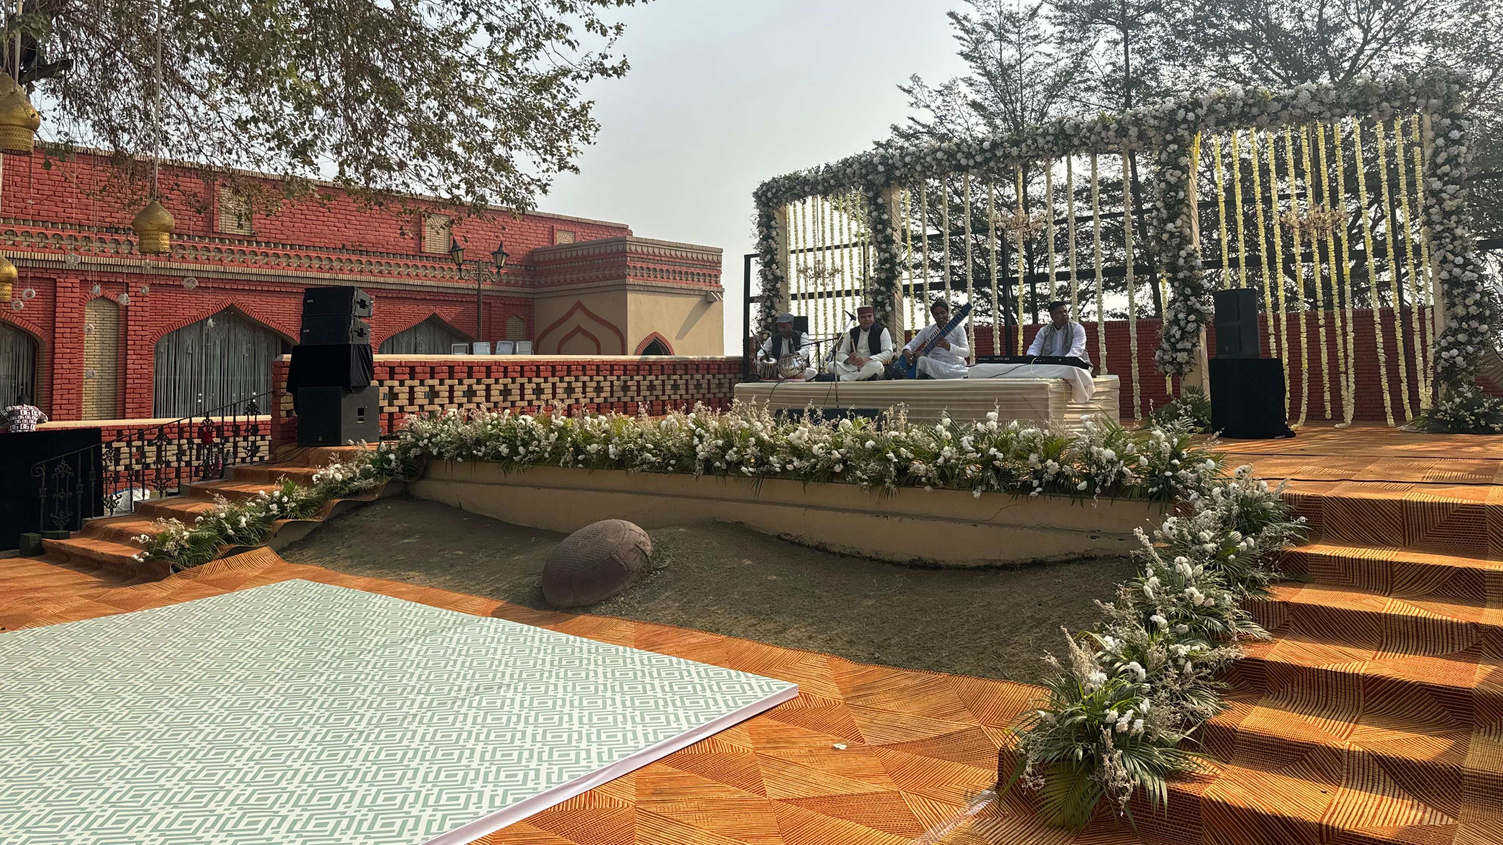

Slide 37
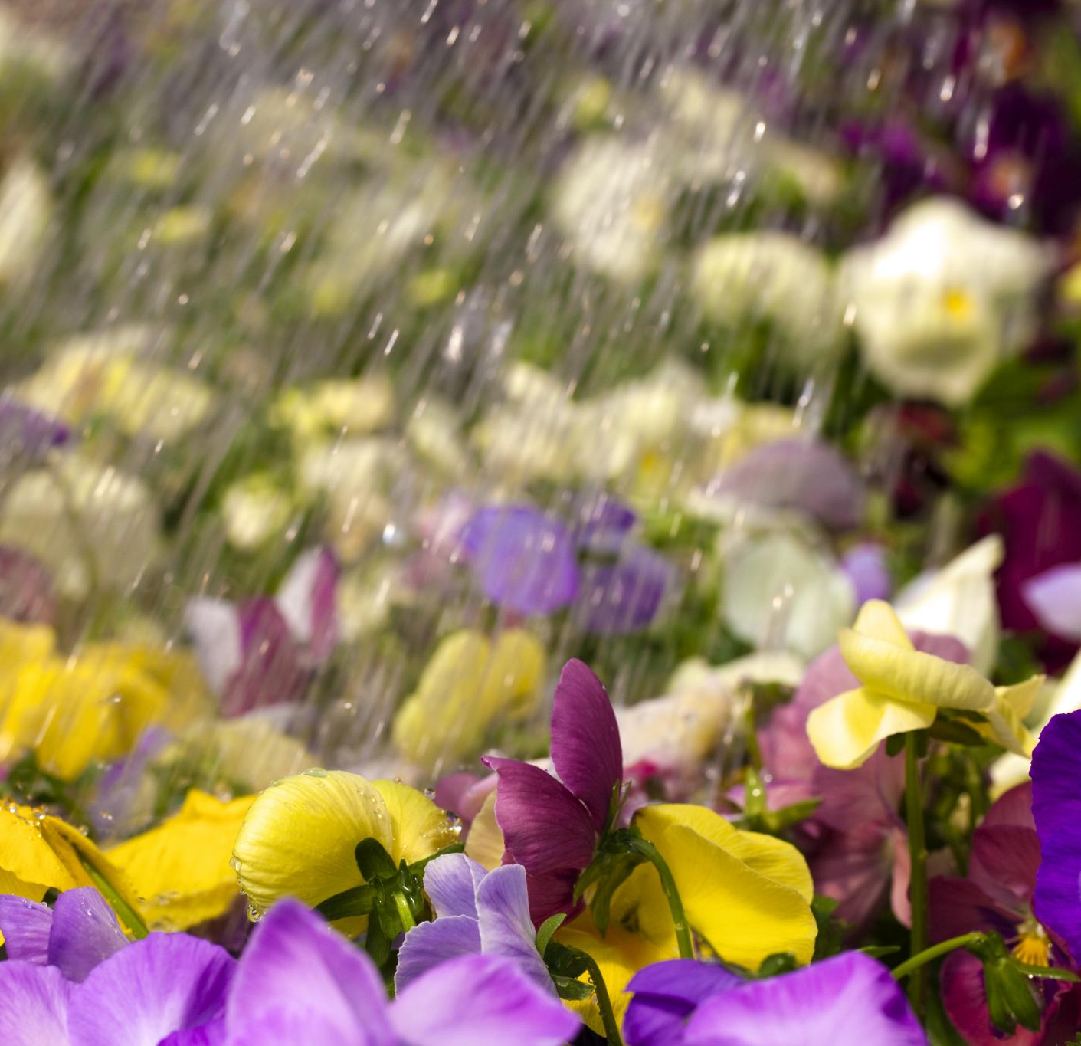
Day Special Effects
Flower Showers
Flower showers create a magical atmosphere by adding elegance and beauty to events, making them visually stunning.
Color Shots
Color shots are energetic and vibrant, often seen in festivals and celebrations, bringing excitement to the crowd.
Perfect for Events
Both effects are perfect for weddings, festivals, and grand openings, providing unforgettable visual experiences.
Notes:
Flower showers create a magical atmosphere for events, adding a touch of elegance and beauty. Color shots, often seen in festivals and celebrations, bring vibrant energy and excitement. Both effects are ideal for weddings, festivals, and grand openings, providing unforgettable visual experiences that captivate audiences.

Slide 38
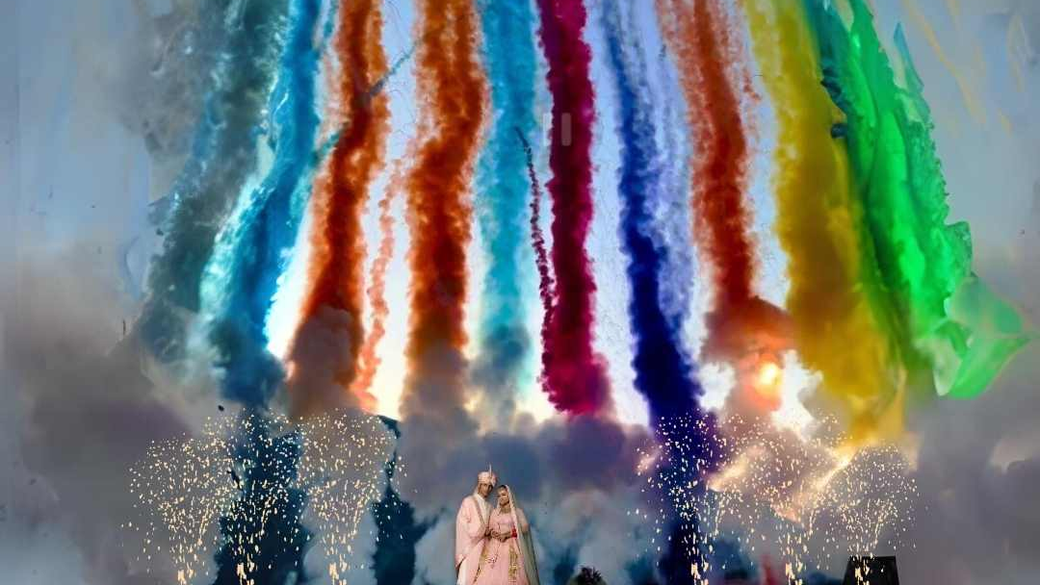

Slide 39
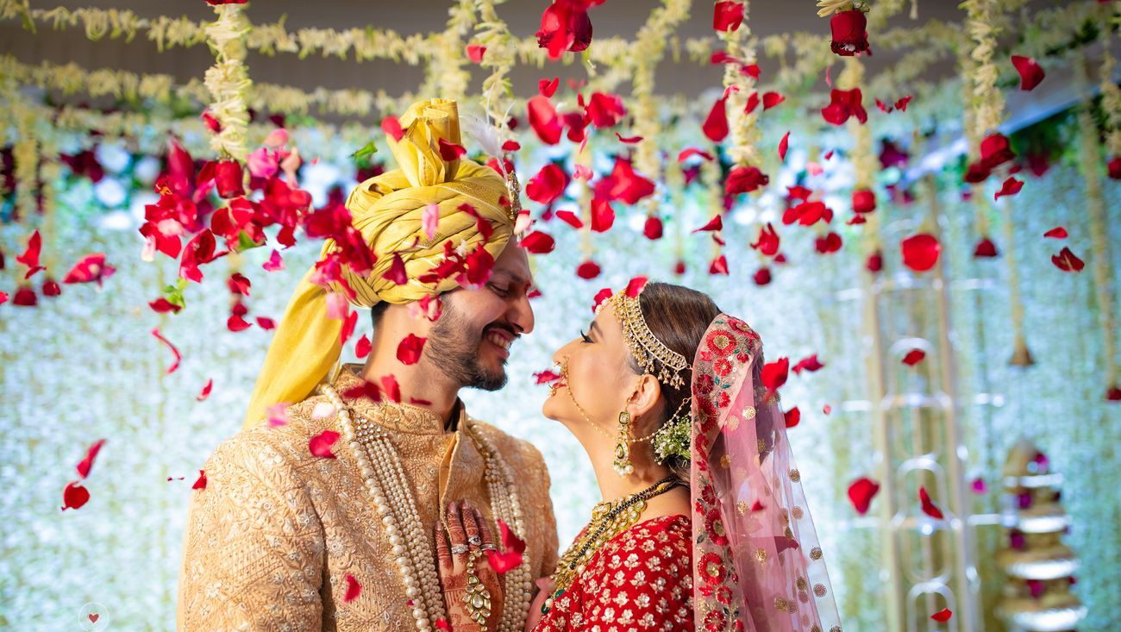

Slide 40

Perfect Evening Wedding
Magical Lighting
Using fairy lights, lanterns, and candles can create a magical and enchanting atmosphere for an evening wedding.
Elegant Decor
Choose decor that complements the nighttime setting, such as deep colors and lush fabrics, to enhance the elegance of the event.
Comfortable Seating and Heating
Plan for comfortable seating and heating options to ensure guests remain cozy and comfortable throughout the evening wedding event.
Notes:
Creating an enchanting evening wedding involves several elements. Lighting is crucial; consider using fairy lights, lanterns, and candles to create a magical atmosphere. Choose elegant decor that complements the nighttime setting, such as deep colors and lush fabrics. Finally, plan for comfortable seating and heating options to ensure guests remain cozy throughout the event.

Slide 41




Slide 42




Slide 43


Slide 44


Slide 45


Slide 46

Magical Wedding Evenings
Cold Pyros
Cold pyros create dazzling sparkles without the heat, enhancing any grand entrance with a touch of magic.
Flower Showers
Flower showers add a romantic, whimsical touch to weddings, perfect for capturing unforgettable and picturesque moments.
Low Fog
Low fog spreads a mystical ambiance that makes first dances seem dreamlike and enchanting.
Fireworks Finale
Fireworks can be the grand finale, illuminating the night sky and leaving guests in awe of the magical celebration.
Notes:
Cold pyros create dazzling sparkles without the heat, enhancing any grand entrance. Flower showers add a romantic, whimsical touch, perfect for capturing unforgettable moments. Low fog spreads a mystical ambiance, making first dances dreamlike. Fireworks can be the grand finale, illuminating the night sky and leaving guests in awe.

Slide 47




Slide 48




Slide 49


Slide 50

Barat Setup Highlights
Mobile DJ Experience
The DJ on Wheels ensures lively music throughout the procession, creating a vibrant and festive atmosphere for all attendees.
Vintage Car Elegance
A Vintage Car adds a touch of elegance and nostalgia, making the event memorable and enhancing its overall charm.
Traditional Barat Band
The Barat Band, with traditional instruments, brings vibrant energy and festive ambiance, enhancing the celebratory spirit of the wedding procession.
Notes:
Barat Setup DJ on Wheels provides a mobile DJ experience, ensuring lively music throughout the procession. A Vintage Car adds a touch of elegance and nostalgia, making the event memorable. The Barat Band, with traditional instruments, brings vibrant energy and festive ambiance, enhancing the celebratory spirit of the wedding procession.

Slide 51




Slide 52




Slide 53



Slide 54

Thank you
Team Soulmate Events
+91- 9253707777 (Uday Maan)
+91 – 9729035555(Azad Sandhu)

